Slide 1
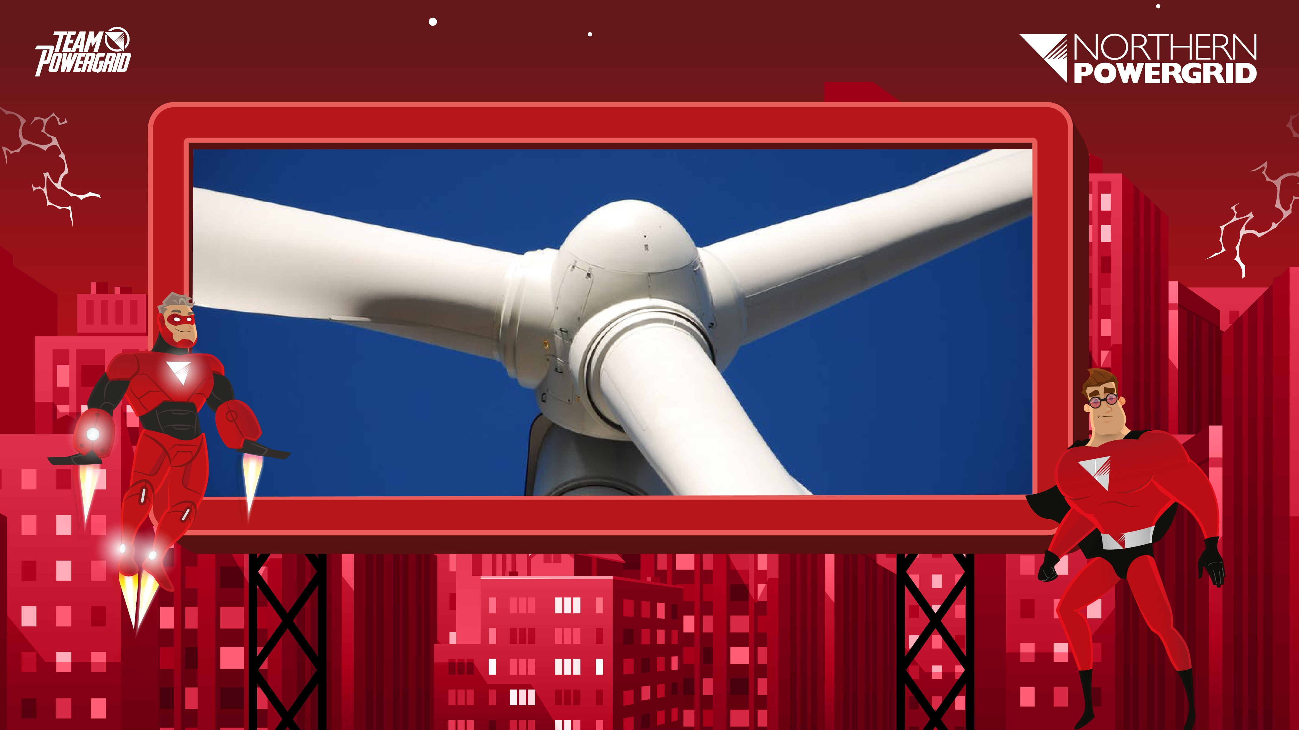
Northern Powergrid:
Efficiency Design
www.northernpowergrid.com/education

Slide 2
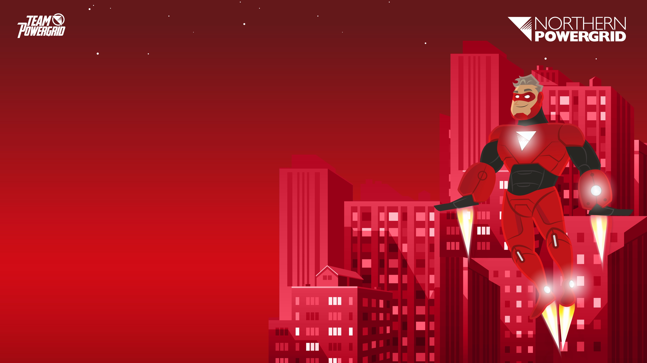
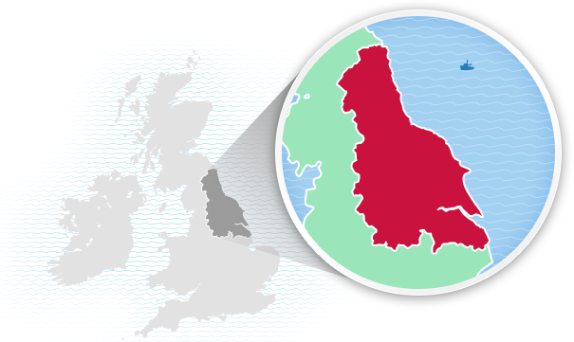
About Northern Powergrid
"Keeping your power flowing…
You may not know who we are but we keep the lights on, the kettles boiling and the phones charged for 8 million people across the North East, Yorkshire and northern Lincolnshire.
Put simply, we make sure the electricity you buy from your energy supplier gets to you safely, whenever you need it. And, if your power ever gets interrupted, for whatever reason, be it extreme weather or emergency maintenance, we’ll be there immediately to fix it - giving 100% day and night, rain and shine, Sundays, Mondays and Christmas days.
Our always-prepared team of energy experts live in your communities, proud to play an essential role in keeping the power flowing to all the homes and businesses they serve.”

Slide 3
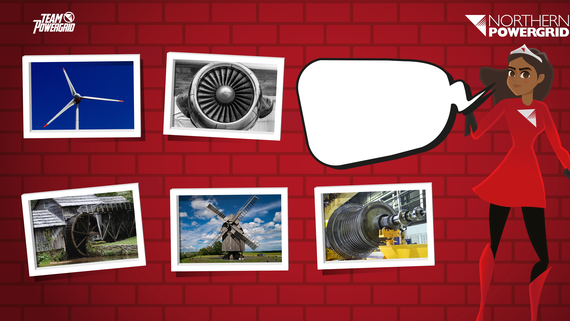
1
2
What is each image of?
Where are they found?
3
4
5

Slide 4
THINK, PAIR, SHARE…
What is each image of?
Wind turbine
Jet engine
Water wheel
Windmill
Steam turbine

Slide 5
Extension:
What aspects of their design help them to function effectively?
Wind turbine
Jet engine
Water wheel
Windmill
Steam turbine

Slide 6
Problems with energy and issues in the UK.

Slide 7
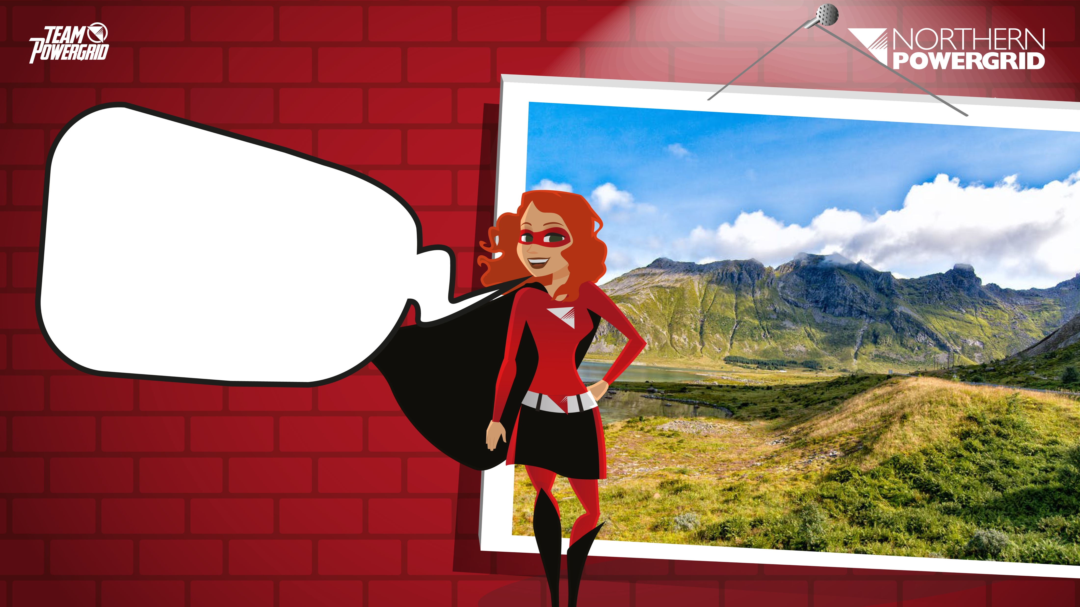
How are we trying to reduce emissions in the future?

Slide 8
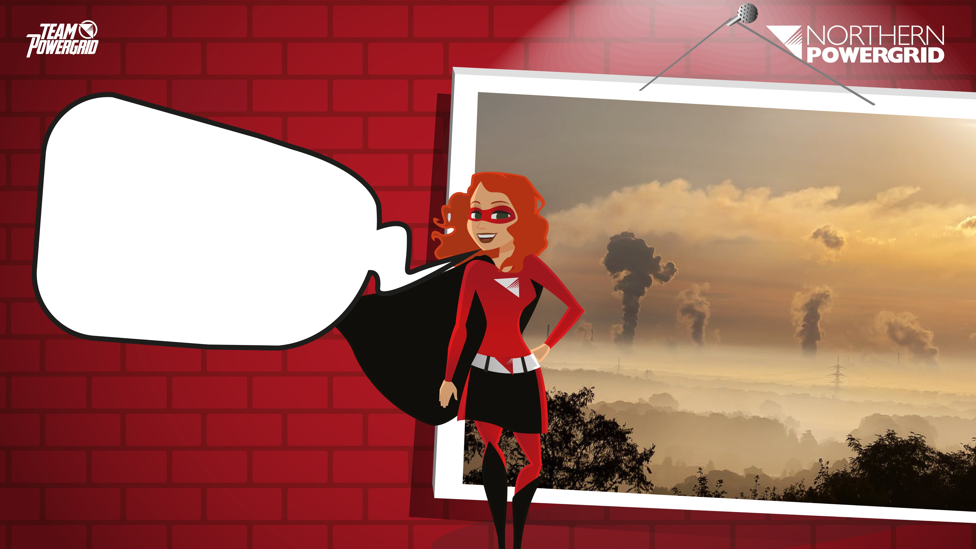
Introduction
Northern Powergrid is committed to looking at ways to reduce emissions in the future.

Slide 9
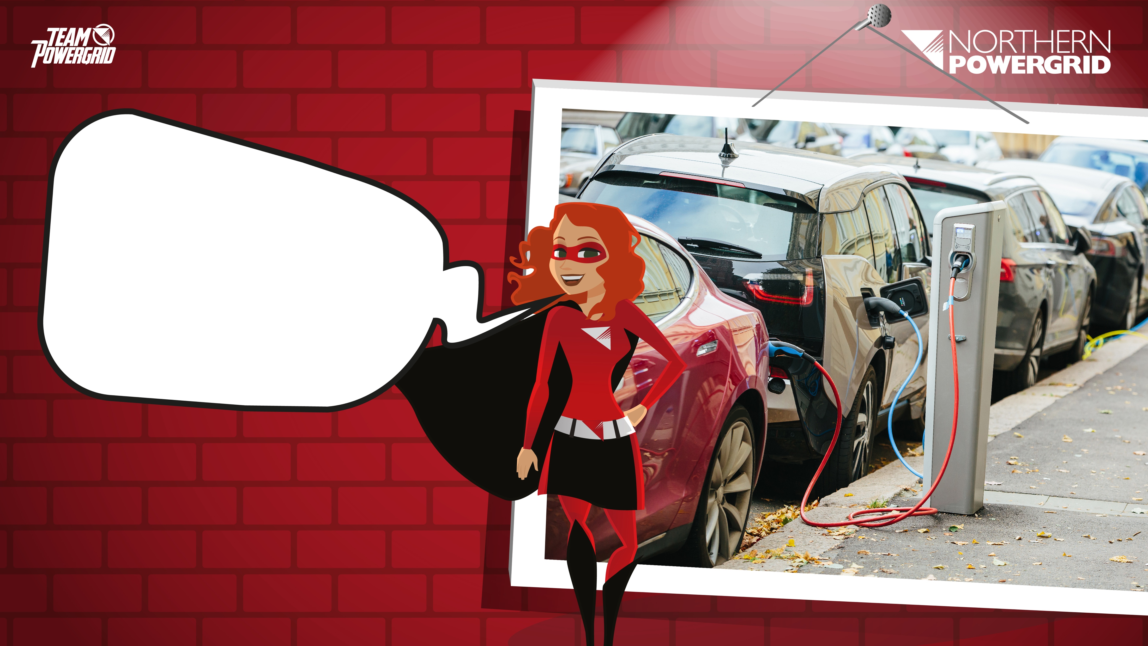
To reduce emissions, people will turn to alternative options, such as electric cars for travel. This shift to more environmental friendly choices will produce a greater demand for electricity.

Slide 10
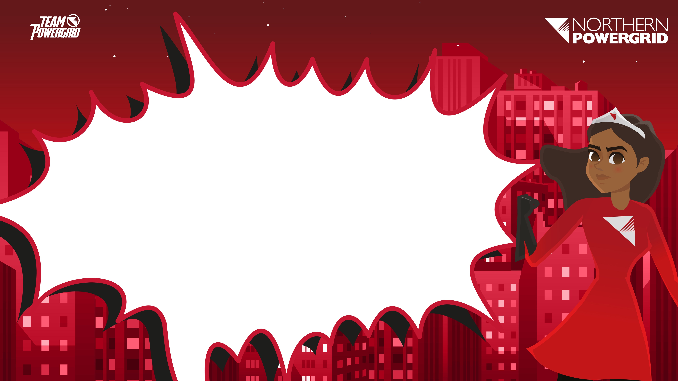
In pairs, discuss how the demand for extra electricity could be met. Evaluate your ideas taking into consideration issues such as environmental factors.

Slide 11
Extension:
Is there a way we could improve any of the available methods of providing energy?

Slide 12
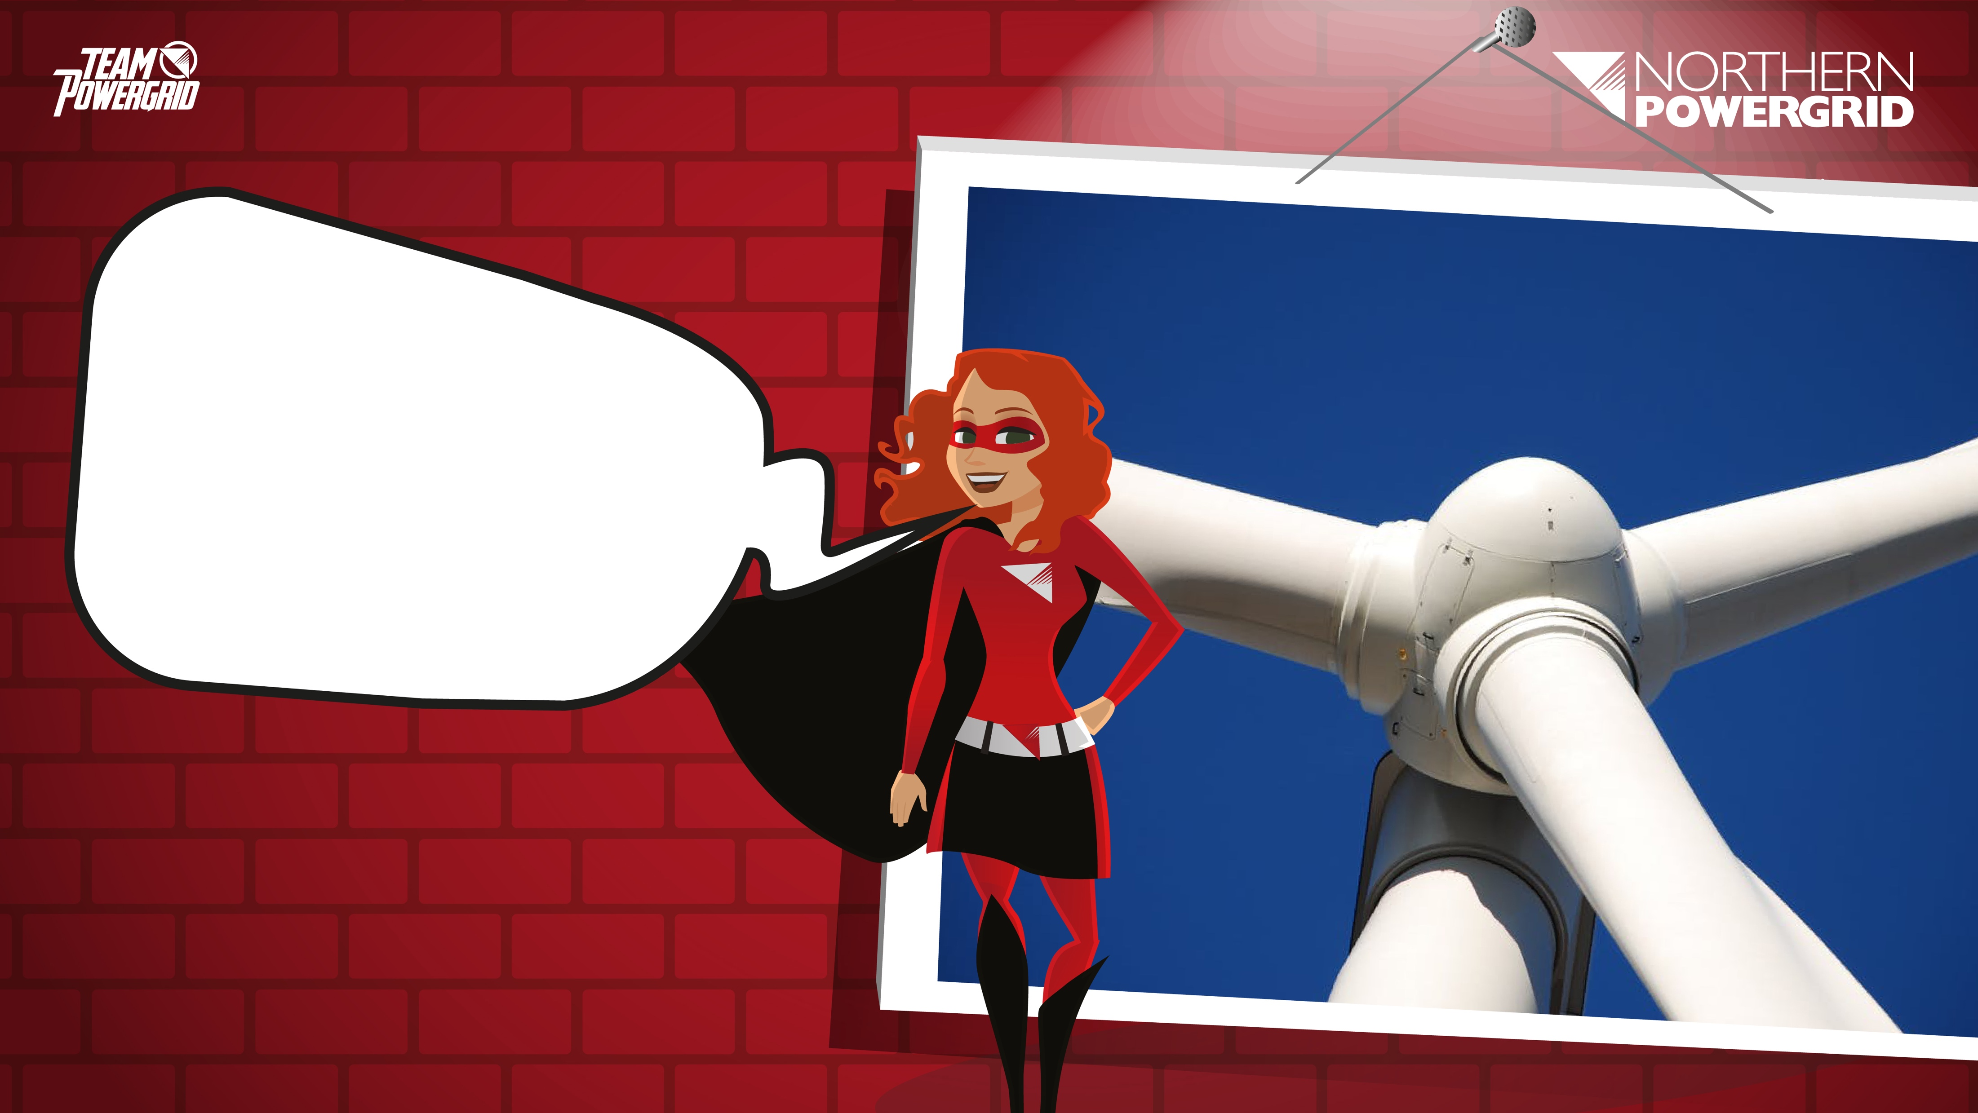
What is a turbine?

Slide 13
What is a turbine?
A turbine is a rotary mechanical device that extracts energy from a moving liquid or gas.

Slide 14
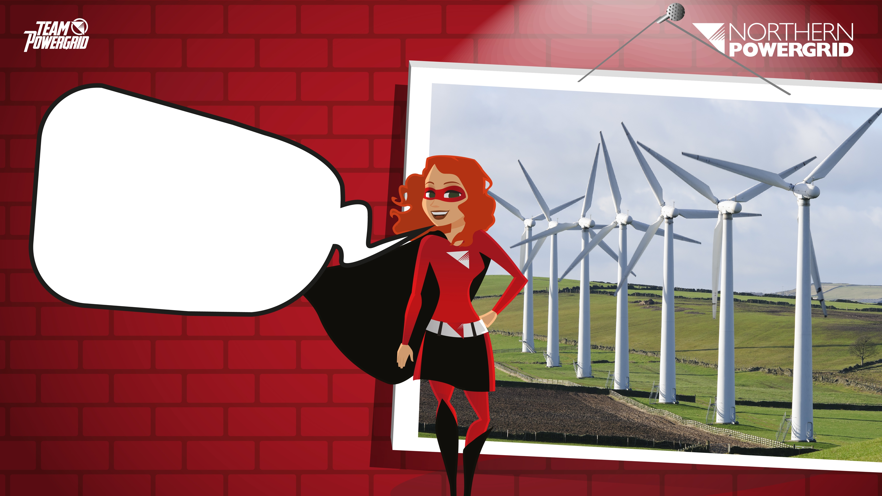
Wind Power:
Designing more efficient turbines that produce more electricity from the same amount of wind could help satisfy increasing energy demands without contributing to climate change.

Slide 15
Wind Power:
How does a wind turbine produce electricity?

Slide 16
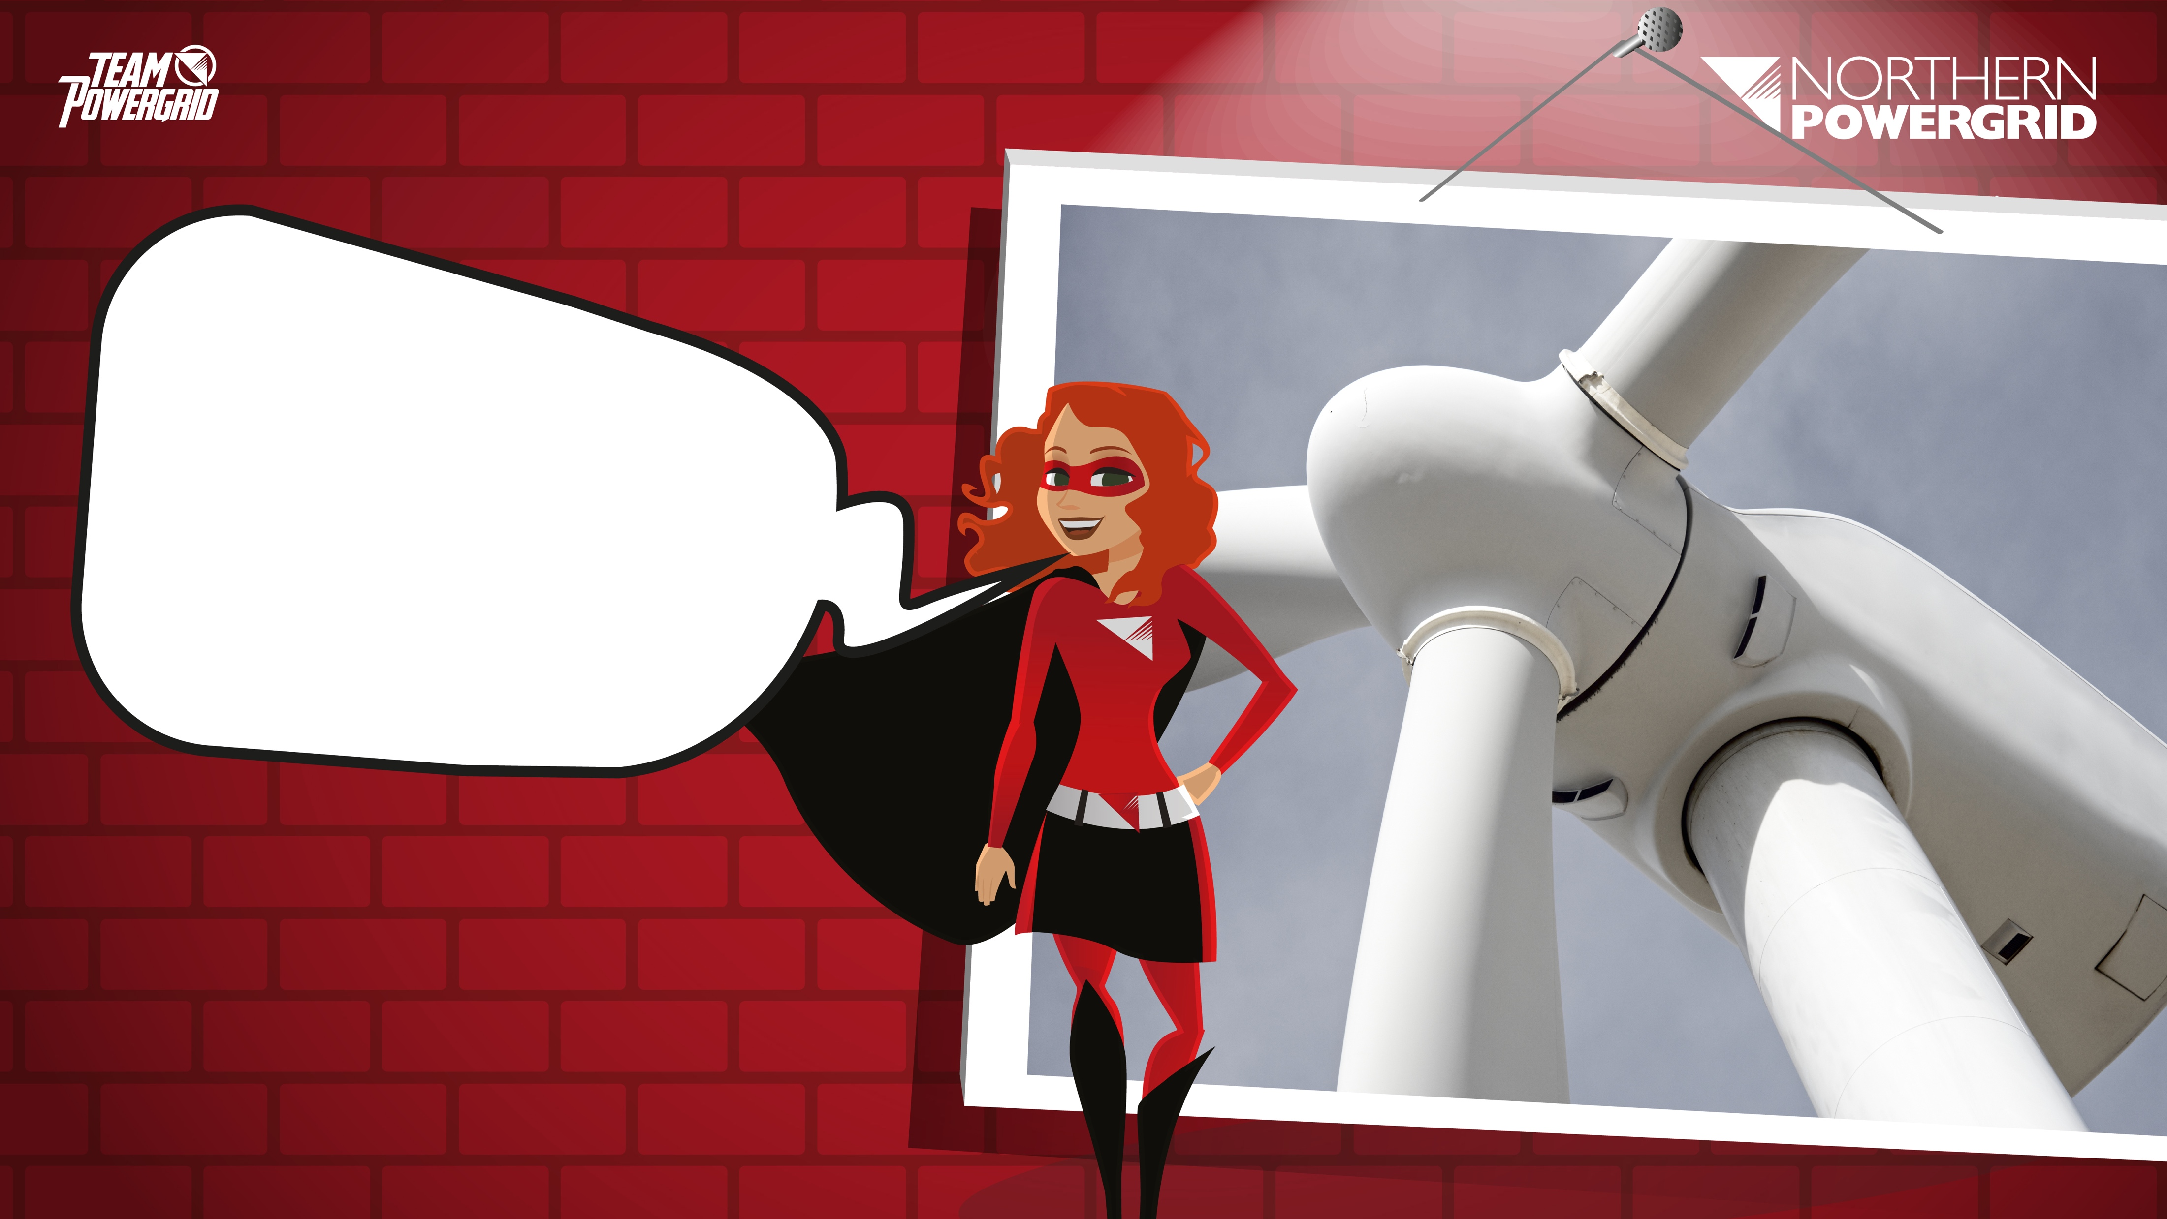
Wind Power:
Energy from the wind acts on the propeller-like blades, turning them around a rotor. The rotor connects to a main shaft, which spins a generator to create electricity.

Slide 17

Challenge:
In groups you need to look at the wind turbine design and consider ways in which it could be more efficient.

Slide 18
You will need to research and consider:
Aerodynamics:
Blade shape
Number of blades
Blade length
Pitch of blades

Slide 19

Your presentation must include:
An introduction to the problem
Possible visual accompaniment e.g. Sketches
Evidence of research
Information on aerodynamics and efficiency
Reference to materials if relevant
A conclusion and evaluation of your design
Clear input from each of the group members

Slide 20
Challenge:
In your groups, present your design to the class.

Slide 21
Your presentation must include:
An introduction to the problem
Possible visual accompaniment e.g. Sketches
Evidence of research
Information on aerodynamics and efficiency
Reference to materials if relevant
A conclusion and evaluation of your design
Clear input from each of the group members

Slide 22
Assessment criteria:
Your presentations will be scored out of 60 with marks given out of 10 in the following areas
Any visuals
Evidence of research
Technical information
Evaluation
Teamwork
Presentation skills

Slide 23
Plenary
You’ve seen a variety of designs from your peers.
For 2 minutes, think about which design fits the brief best and why. Next, discuss this with your partner and share your ideas with the class.

Slide 24
Next Steps
For homework, research how else the efficiency of a wind farm could be improved.

Slide 25
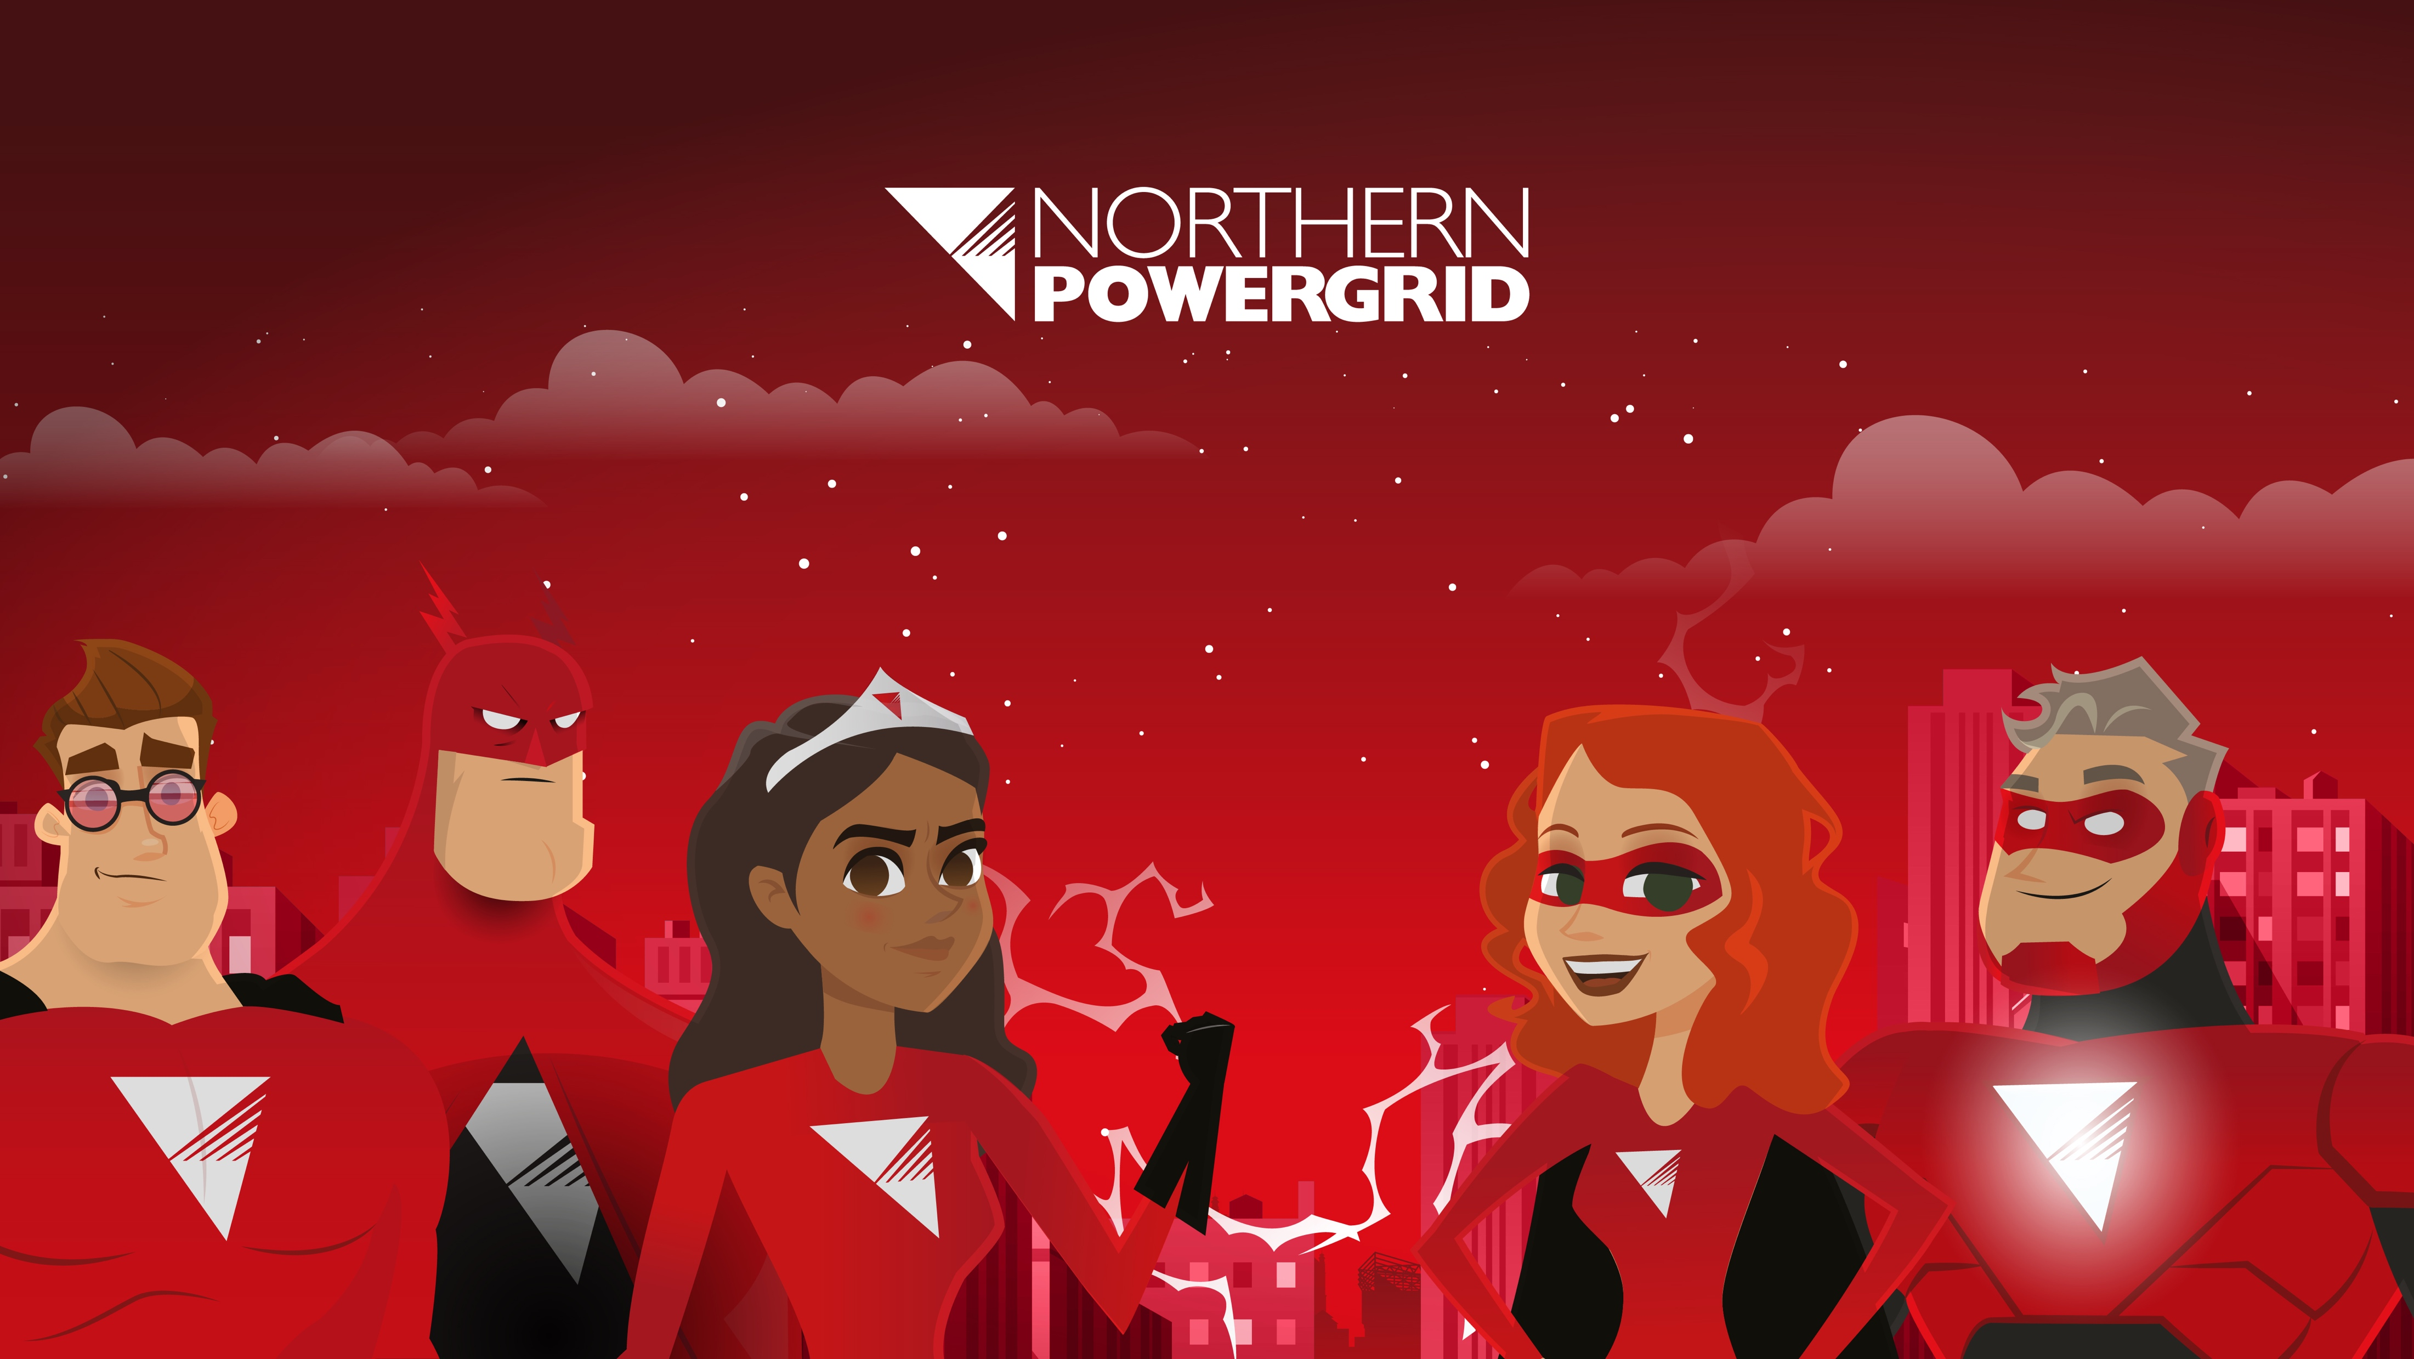
Well done!

