Slide 1

Northern Powergrid:
Energy In The Home
www.northernpowergrid.com/education

Slide 2

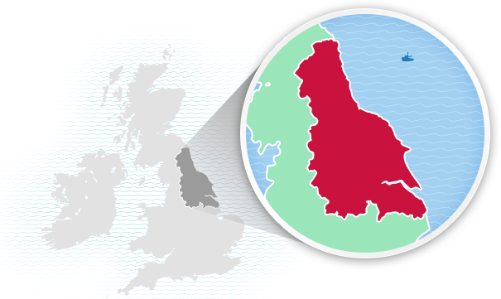
About Us
"Keeping your power flowing…
You may not know who we are but we keep the lights on, the kettles boiling and the phones charged for 8 million people across the North East, Yorkshire and northern Lincolnshire.
Put simply, we make sure the electricity you buy from your energy supplier gets to you safely, whenever you need it. And, if your power ever gets interrupted, for whatever reason, be it extreme weather or emergency maintenance, we’ll be there immediately to fix it - giving 100% day and night, rain and shine, Sundays, Mondays and Christmas days.
Our always-prepared team of energy experts live in your communities, proud to play an essential role in keeping the power flowing to all the homes and businesses they serve.”

Slide 3

Northern Powergrid get energy to your home, they don't produce it. But do you know of any methods that are used to produce electricity?
Which are renewable and non-renewable?

Slide 4

Extension
Can you think of advantages and disadvantages for each?

Slide 5

THINK, PAIR, SHARE…
What ways can you think of to help reduce your energy use at home?

Slide 6
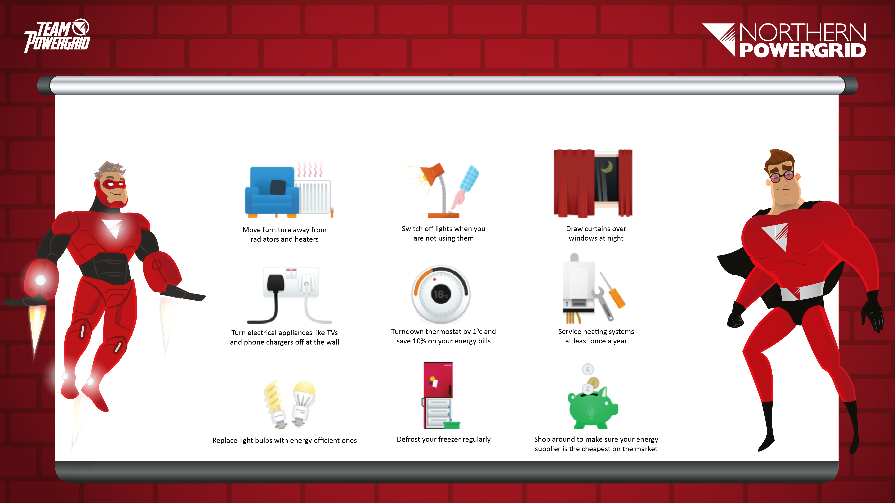
Northern Powergrid give the following advice to help people save energy at home:
Notes:
Show a series of pictures without giving away the topic of the lesson.
Students to discuss what they think is happening in the pictures.
What are the issues for consideration?
What lies within our areas of responsibility?
What are the immediate priorities? Consider the What, Why, When and How when exploring solutions.
Who else do we need to work with?
How do you think people feel?

Slide 7
How would these help you to save energy? Write your answers on the sheet provided.
Notes:
Show a series of pictures without giving away the topic of the lesson.
Students to discuss what they think is happening in the pictures.
What are the issues for consideration?
What lies within our areas of responsibility?
What are the immediate priorities? Consider the What, Why, When and How when exploring solutions.
Who else do we need to work with?
How do you think people feel?

Slide 8

Introducing: Energy Costs In The Home
Look at this example bill. What do you notice?
Notes:
Show a series of pictures without giving away the topic of the lesson.
Students to discuss what they think is happening in the pictures.
What are the issues for consideration?
What lies within our areas of responsibility?
What are the immediate priorities? Consider the What, Why, When and How when exploring solutions.
Who else do we need to work with?
How do you think people feel?

Slide 9

Energy costs
in the home:
What unit is used to measure energy
measured in
the home?

Slide 10

Energy costs
in the home:
Different companies charge different amounts for electricity, one company currently charges 17p per kWh.

Slide 11

If you used a hairdryer for 30 minutes a day for 7 days how much would it cost if it was a 1500W hairdryer?
Don't forget to take the units into account!

Slide 12

Convert 1500W to kW = 1.5kW
The Solution
Work out the number of hours the hairdryer is on for
0.5 x 7 = 3.5hrs
Work out the cost
Cost = 1.5 kW × 3.5 h × 17p
= 89.25p

Slide 13
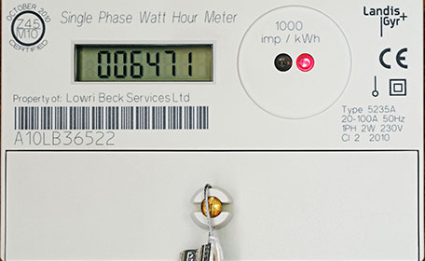
Reasoning – Energy costs in the home:
The readings show the number of units (kWh) used by someone in their home. The price per unit (kWh) is 17.10p
How much would their bill be?
Previous Meter Reading
21300
Current Meter Reading
22705

Slide 14
Calculate the number of units used
The Solution
22705 – 21300 = 1405 units
Calculate the cost of the bill
1405 x 17.10 = 24025.5p
= £240.26

Slide 15
Extension:
There is a standing charge of 18.90p per day. The billing period is 90 days. What is the cost
of the total bill?
Previous Meter Reading
21300
Current Meter Reading
22705

Slide 16
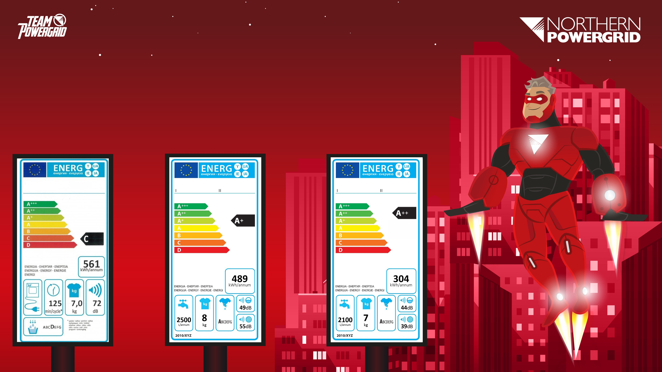
Group Task:
The energy efficiency labels below give information about different washing machines. Based on what you can see on the label, which do you think is most energy efficient? Why?
1
2
3
Notes:
t

Slide 17

Scenario
Staff at Northern Powergrid are looking to advise residents in a town of the best and most cost effective ways to reduce energy usage in their homes.
Notes:
Think, pair, share = take a minute to think, discuss this with a partner, then share yours ideas with the class.

Slide 18
Scenario
They want to run a campaign in the local area to promote this, however, they need to work out what energy saving method the residents are most likely to utilise.
Notes:
Think, pair, share = take a minute to think, discuss this with a partner, then share yours ideas with the class.

Slide 19

Task
In your groups you will need to use the information in the diagram to work out what energy saving method they should promote. You could use the internet and/or some textbooks to do some research, too. In order to make your recommendation to Northern Powergrid, you will need to show all working out and include written explanations for any conclusions.
The community have expressed their concerns to the local council who have agreed to have a community meeting to enable local residents to present their thoughts on the proposed plans.
Notes:
In this context, “power sharing” refers to multiple households drawing their power from a limited supply of generators. Power sharing means households may only have limited access to electricity, to fulfil their basic energy needs.

Slide 20
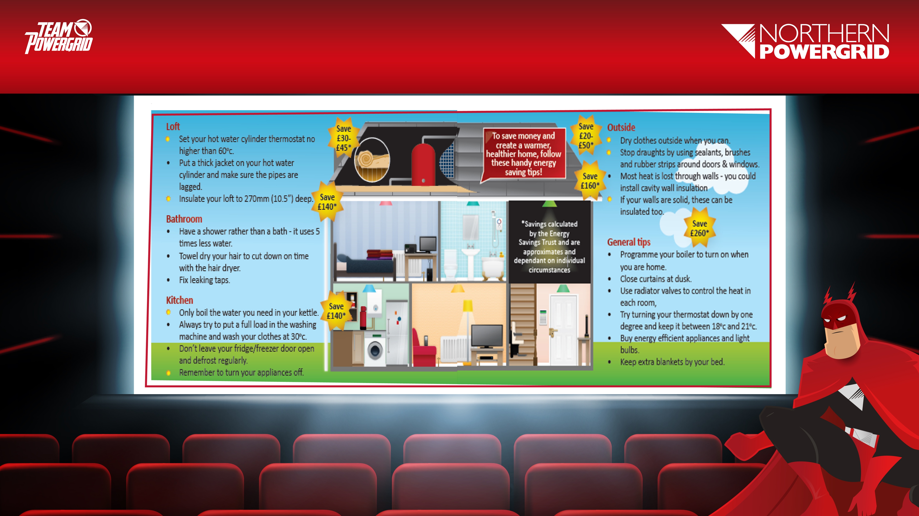

Slide 21
Plenary:
Share your ideas and reasoning.

Slide 22

Next Steps
What energy saving techniques could you implement at home? Can you list 3 changes you could make to your daily routine that would save energy?

Slide 23

Well done!

