Slide 1
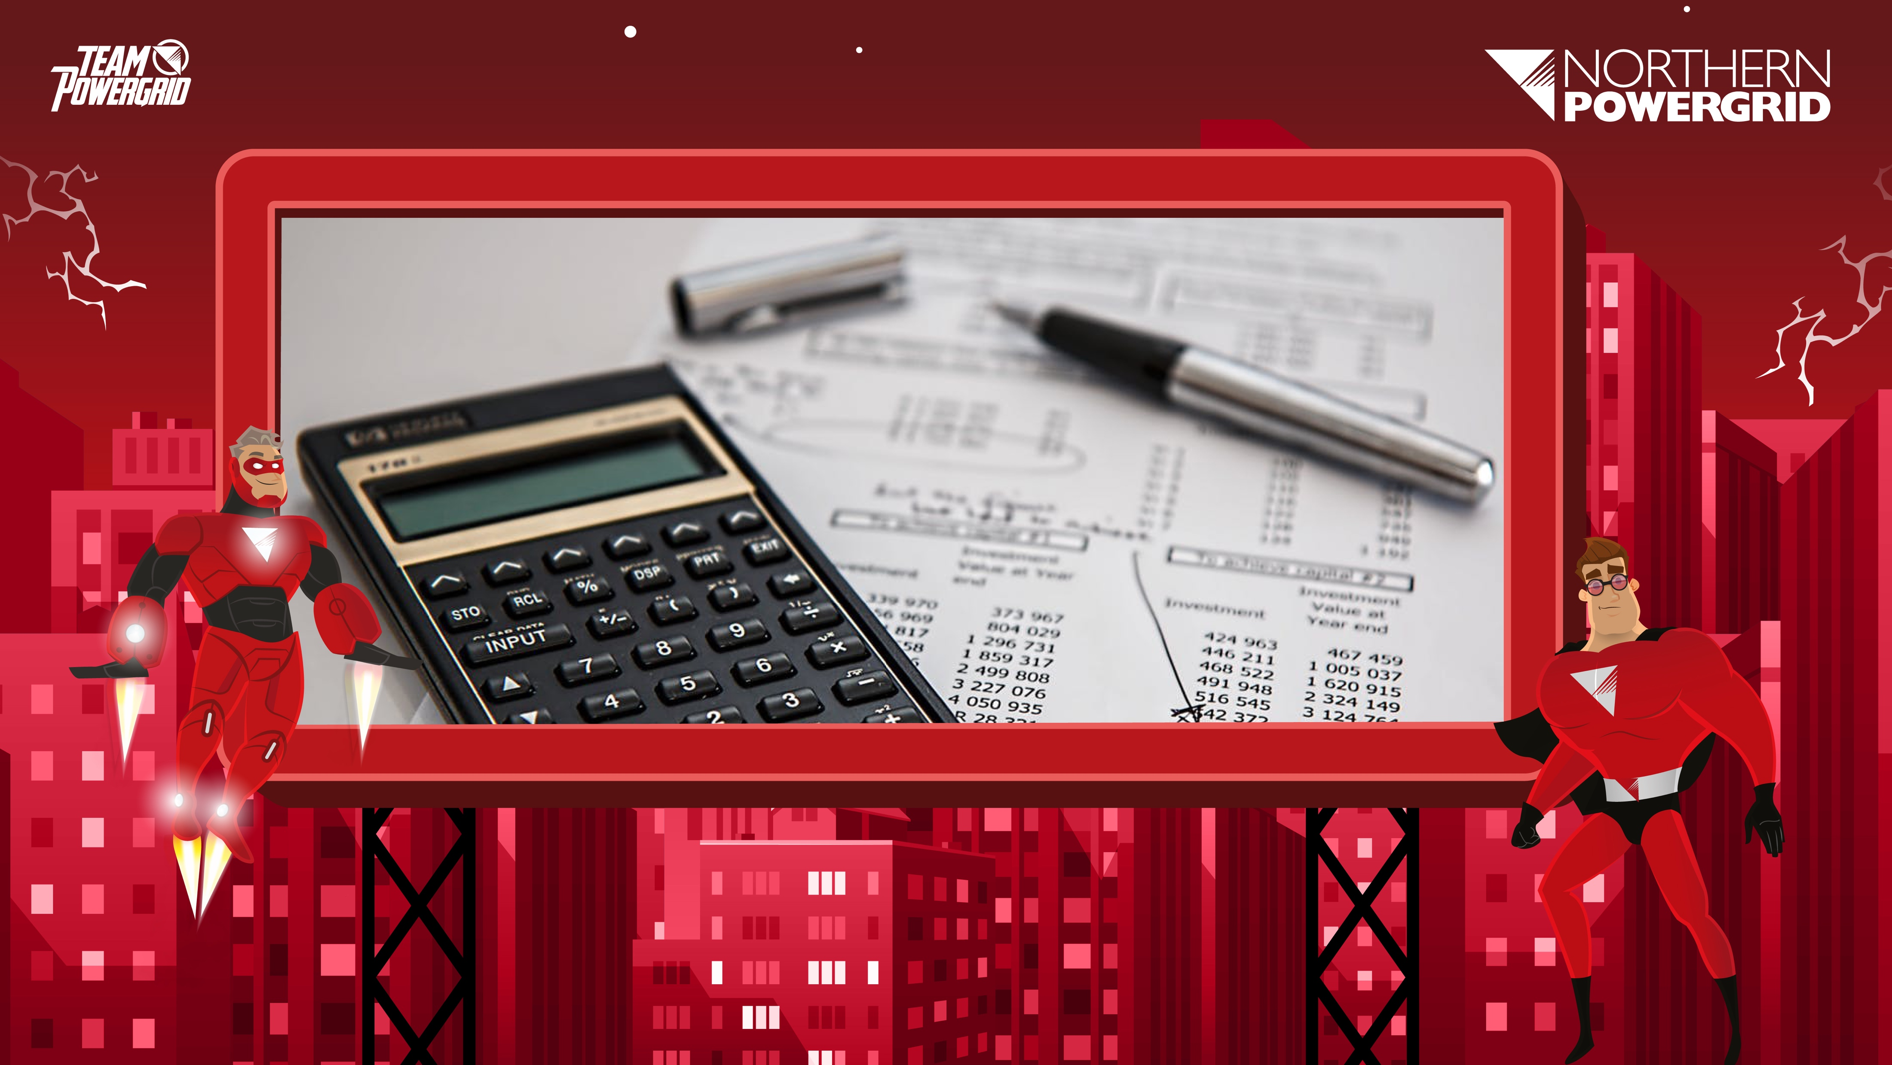
Northern Powergrid:
Calculating the Cost of Electricity
www.northernpowergrid.com/education

Slide 2

How much do you think your parents/carers pay for your electricity and gas every year?
The average cost in 2016 was £1,123.
What goes into this cost? How do energy suppliers decide what to charge?

Slide 3
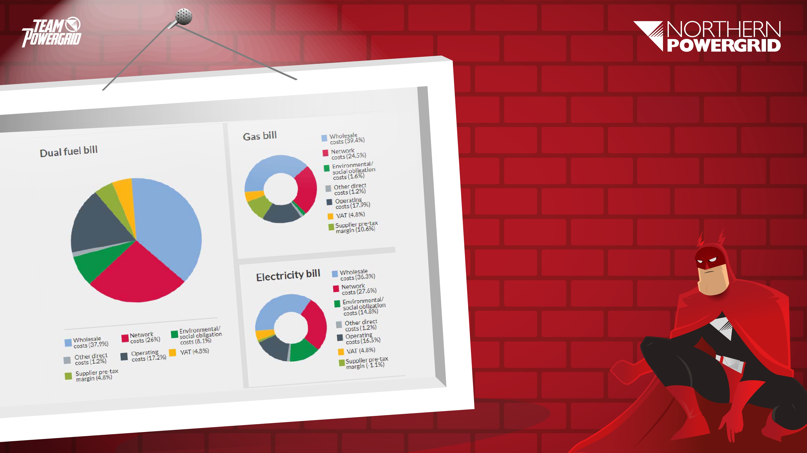
Breakdown
of Your Bill.

Slide 4
Breakdown of Your Bill
Energy Suppliers split their costs over the following factors:
37.9% Wholesale Costs
The cost of buying energy from the Energy Market – heavily reliant on the cost of oil.
26% Network Costs
The running cost of the electricity and gas distribution and transmission networks, including Northern Powergrid, who ensure the supply of energy continues to flow; along with charges from National Grid.

Slide 5
Breakdown of Your Bill
17.2% Operating Costs
The costs incurred by the energy suppliers in running their day to day operations.
8.1% Environmental and Social Obligation
Costs incurred in developing a greener, future proof network, such as low carbon energy, smart metering and green power generation.
4.8% Supplier pre-tax margin
The profit that a supplier is allowed to make.
4.85% VAT.

Slide 6
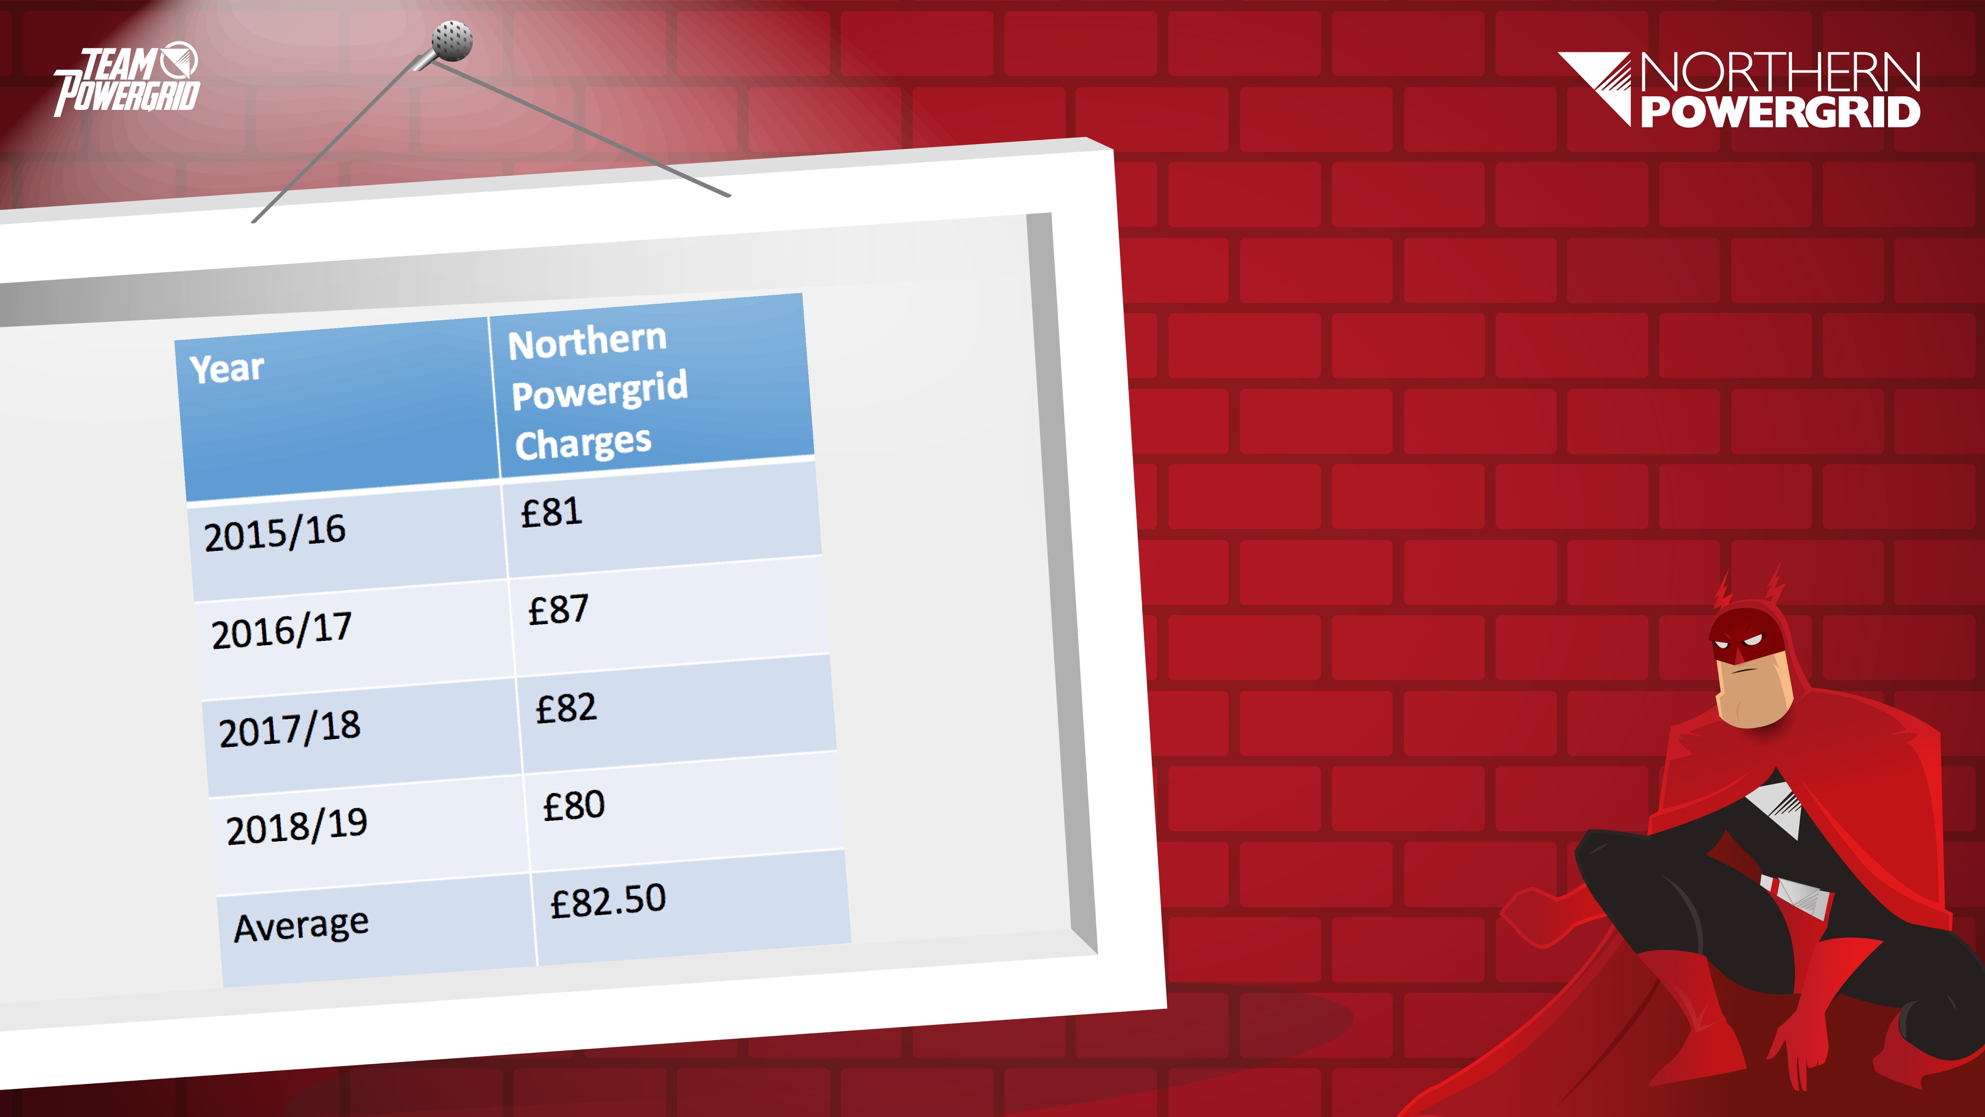
How much does Northern Powergrid charge suppliers?
On average, Northern Powergrid charges energy suppliers £82.50 a year in distribution costs.
The energy suppliers then pass on this charge to customers. Northern Powergrid charges make up around 10% of electricity bills.
This means your parents and carers pay around £83 a year to have a reliable, safe supply of electricity which is available 24/7.

Slide 7
How do these charges compare to other services and products?
Northern Powergrid charges:
  £83/year, 23p/day.
Full Sky subscription:
  £978/year, £2.68/day.
iPhone 8 on contract:
  £774/year, £2.12/day.
A Freddo bar a day:
  £91.25/year, 25p per day.
What would you rather spend 25p a day on?
1 Freddo bar per day.
Or a reliable, consistent connection to the electricity grid, keeping the lights shining, your music blaring and your games console playing.

Slide 8

Dividing by 1000
We’ll be using this calculation to convert Watts per hour into kWh, so let’s practise!

Slide 9

Divide these numbers by 1000:
2.34
243.7
91835
0.4
9173
87.36

Slide 10
Divide these numbers by 1000:
2.34 ÷ 1000 = 0.00234
243.7 ÷ 1000 = 0.2437
0.4 ÷ 1000 = 0.0004
9173 ÷ 1000 = 9.173
87.36 ÷ 1000 = 0.08736
91835 ÷ 1000 = 91.835

Slide 11
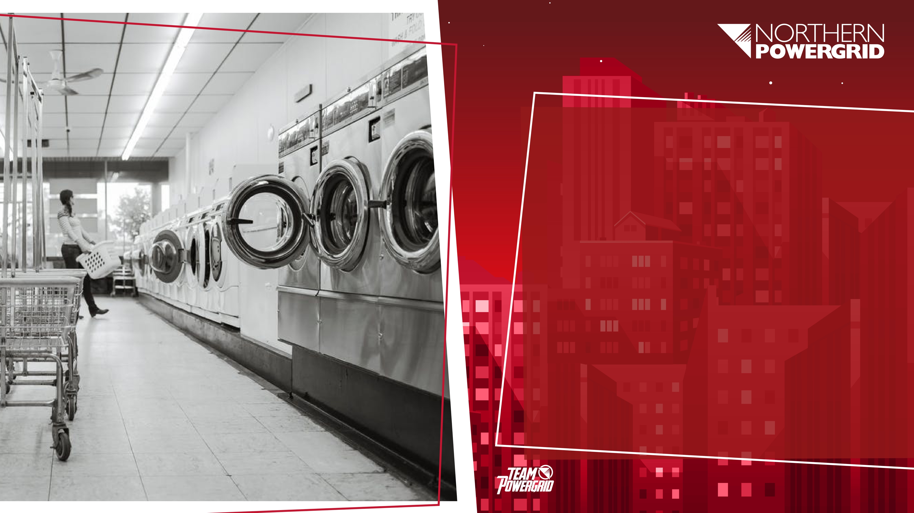
Converting from Watts to kW:
A washing machine uses 1200W per hour.
If there are 1000W in 1kW, how can we work out 1200W in kW?

Slide 12
Converting from Watts to kW:
A washing machine uses 1200W per hour.
If there are 1000W in 1kW, how can we work out 1200W in kW?
1200
÷ 1000
= 1.2
1.2 kW
This machine uses 1.2kW per hour

Slide 13
Converting from Watts to kW:
If there are 1000W in 1kW, we divide by 1000, so 1200W is the same as 1.2kW
A washing machine that uses 1200kW in and hour uses 1.2kWh of energy.

Slide 14
To work out the cost of running our washing machine for 1 hour, we need to multiply the kWh used (1.2 kWh) by the cost of 1kWh (15p)
1.2
x 15
= 18
18p
This machine costs 18p to run for an hour

Slide 15
So, if our washing machine uses 1.2kWh, and 1kWh costs 15p, how much will it cost to run this machine for 2 hours?
Show your working.
1.2
x 15
= 18
18
x 2
= 36
36
This machine costs 36p to run for 2 hours

Slide 16

A toaster uses 800w per hour.
This is ______ kwh
0.8

Slide 17
Electricity costs 15p per kWh.
______ kwh x 15 = ______ p
0.8
12

Slide 18
This toaster is used for 30 minutes per day. How much does the toaster cost to use per day?
6p per day

Slide 19

“Over a week, I use my hairdryer for an hour in total.
My hairdryer uses 1800 watts per hour – that’s 1.8kWh.
I’m charged 15p per kWh.
How much is my hairdryer costing me every week?”
27p per week

Slide 20
Extension:
“I always use my hairdryer for the same length of time, 7 nights a week. How much is my hairdryer costing me per night?”
4p per night (rounded up)

Slide 21

Let’s work out how much a fresh cup of coffee costs to make! Try the challenge!

Slide 22
“A coffee machine
uses 0.8kWh of energy. At 15p per kWh, this costs 12p per hour.”

Slide 23
Hang on! It only takes me 5 minutes to make my morning coffee.
How much does this cost?
There are 12 lots of 5 minutes in an hour, so:
12 ÷ 12
= 1
It costs me just 1p to make a fresh cup of coffee in the morning

Slide 24
Extension:
How much will it cost me to make a fresh cup of coffee
every morning for a week?
7p

Slide 25
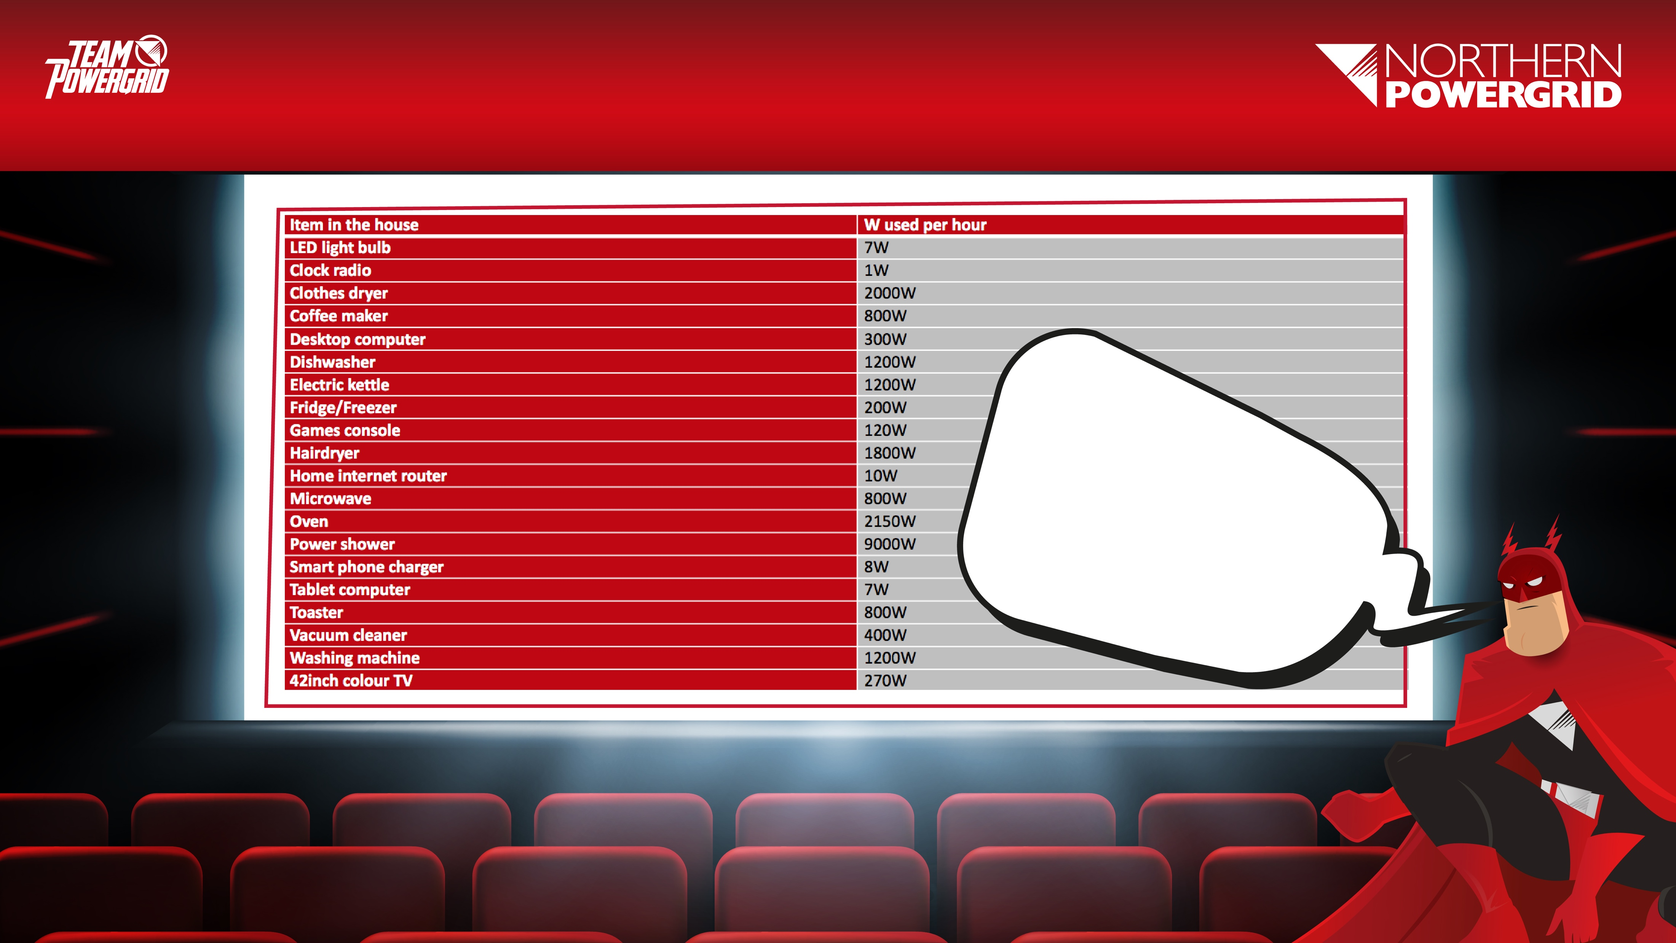
Task:
You’ll be given a table like this one. First, you’ll need to convert watts per hour into kWh.

Slide 26
Task
Using your table of items found around the house, you are going to choose your top 7 “most frequently used” items and work out how much it costs to use them in a single day.
If there’s something missing from the list, you may be able to research the item and the amount of kWh it uses.
You’ll need to think about the items you have chosen and the length of time you use each one for, then you can calculate how much each item costs to use/ run.
Work this out using the price of 15p per kWh as your basis.

Slide 27

Remember
You will initially be working out cost per hour of usage. So, you will need to either multiply or divide your answers depending on whether use that item for more or less than an hour per day.

Slide 28
Extension
Paying for electricity monthly, as you use it, can cost 16.42p per kWh
Paying for electricity automatically by Direct Debit every month might cost 14.71p per kWh
Using your list of the items you use most, calculate the difference in price if you were paying for these by direct debit instead of monthly, as you use it.

Slide 29
Extension Hints
For each item, you will need to know both the kWh and the estimated length of time per month that you use it.
Once you’ve calculated the cost of paying monthly, as you use it and the cost of paying automatically by Direct Debit, you can then work out the difference in price by subtracting the highest total from the lowest total.

Slide 30
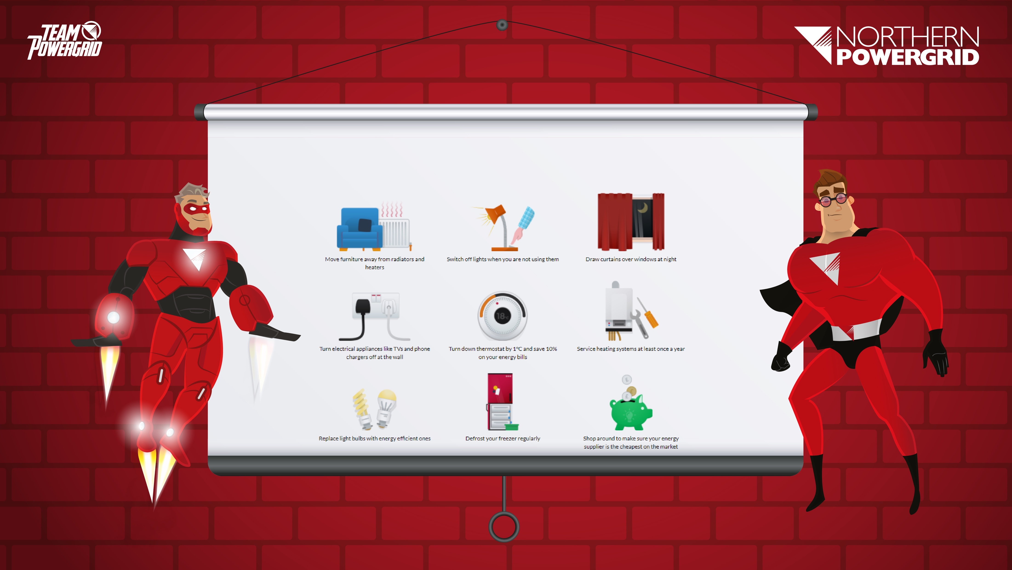
Using less energy is another way to save money. Northern Powergrid gives the following advice to help people save energy at home:
Notes:
Show a series of pictures without giving away the topic of the lesson.
Students to discuss what they think is happening in the pictures.
What are the issues for consideration?
What lies within our areas of responsibility?
What are the immediate priorities? Consider the What, Why, When and How when exploring solutions.
Who else do we need to work with?
How do you think people feel?

Slide 31
Plenary & Class Discussion
Whose “frequently used” household items use the most energy? How much have you estimated this will cost per day?
Which items do you think you could use less in order to reduce the cost of your energy consumption?
How will you do this? What habits and behaviours will you have to change and how will this impact on your daily routine? Do you know any techniques for saving energy?

Slide 32

Next Steps
Thinking about how much energy costs, how much can you reduce the amount of energy consumed (and money spent on electricity) in your household?
For homework, take another look at your list of frequently used items. How much could you reduce your use of each one? Work a revised estimate of how much you will use each item per day.
Using these new figures, work out how much money this will save your household each day, month, and year.

Slide 33
Challenge:
Research ways in which kettles and washing machines can be used more efficiently. What other household items can you find energy-saving advice for?

Slide 34

Well Done!

