Slide 1
Northern Powergrid – Engineering: Problem Solving and Power Issues
www.northernpowergrid.com/education

Slide 2
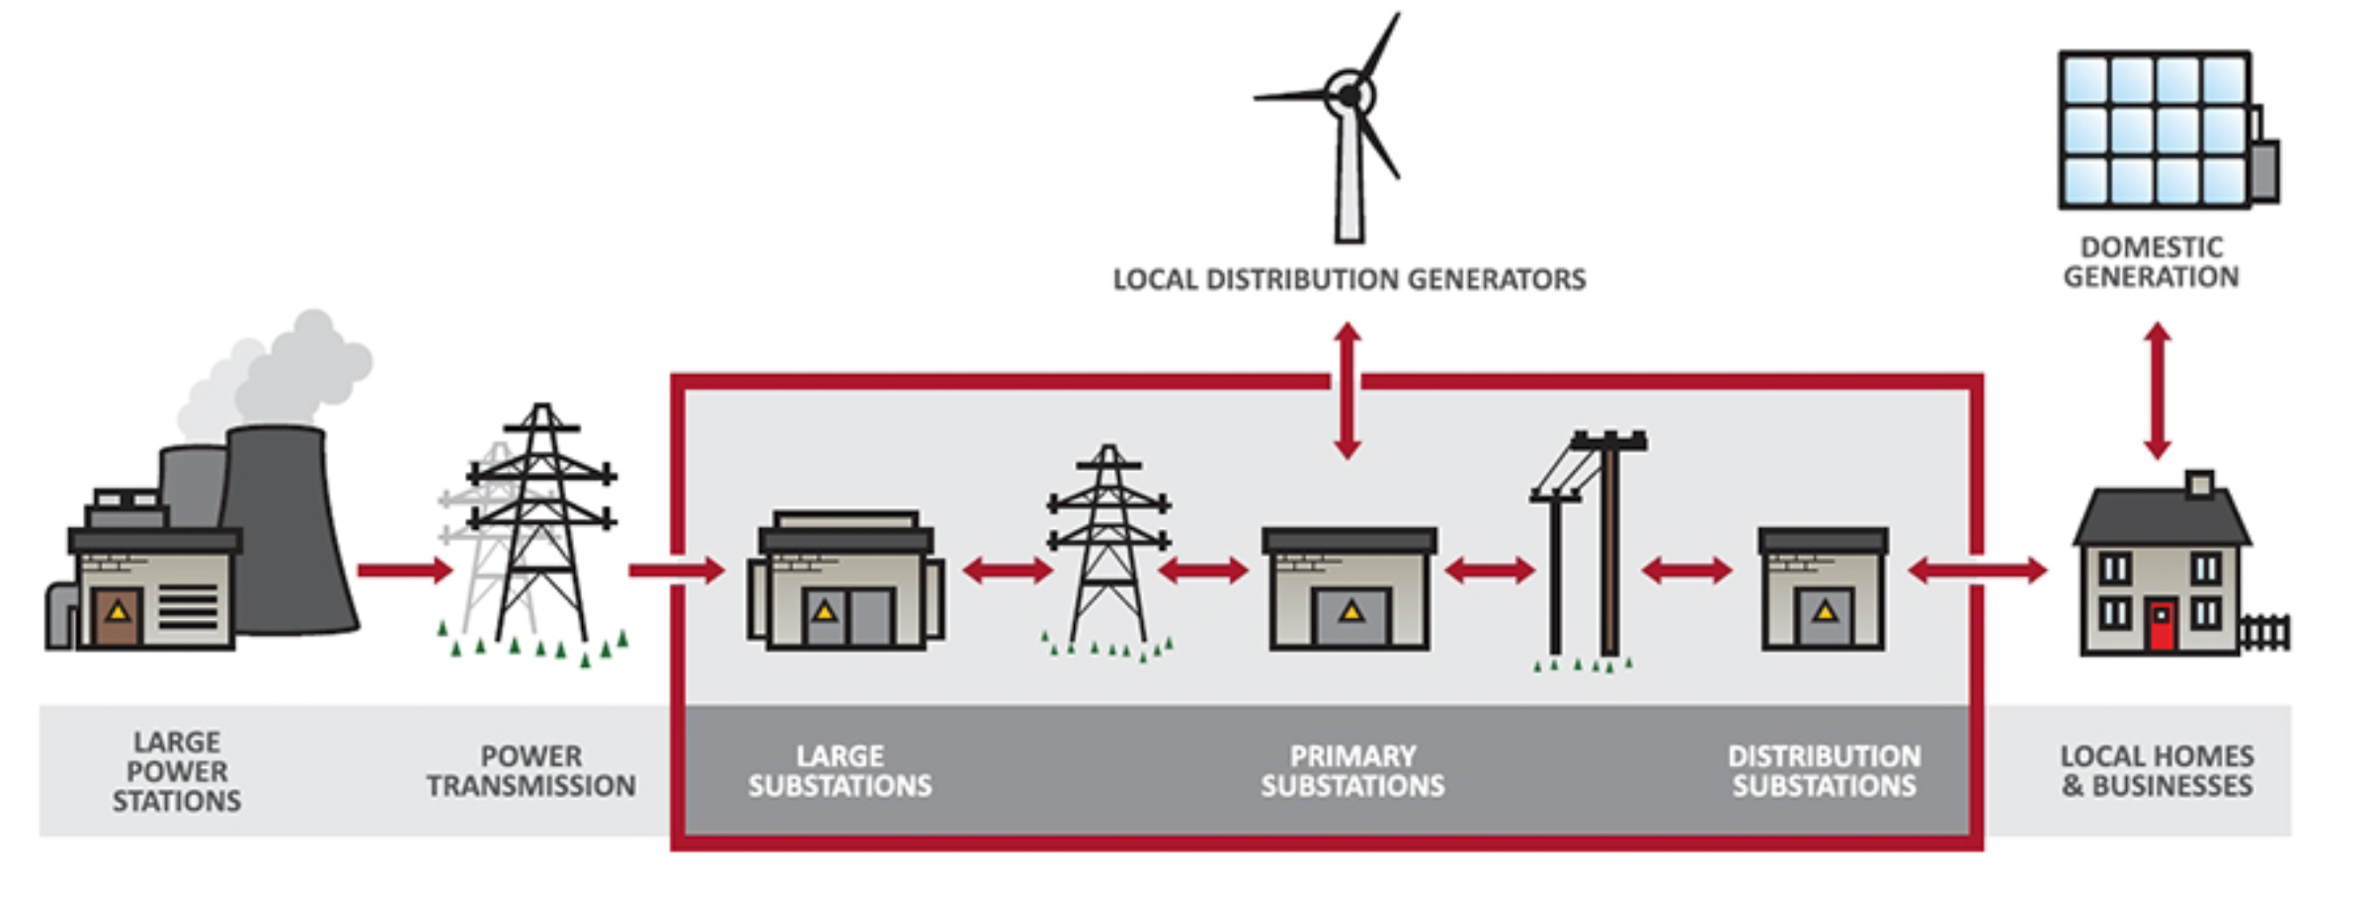
Northern Powergrid is the Distribution Network Operator (DNO) for the North East of England, Yorkshire and northern Lincolnshire.
We distribute electricity to 3.9 million homes and businesses.
As a DNO we do not own the energy we distribute – we charge electricity suppliers for the use of our overhead lines and cables to move energy they purchase from generators to the customers they supply.
This charge to suppliers represents around 10% of customer’s bills.

Slide 3
Learning Objectives
To work in a team to find solutions to real world problems given.
To gain understanding of potential job roles in utilities.
To justify decisions made when facing a design problem.
Notes:
Show a series of pictures without giving away the topic of the lesson.
Students to discuss what they think is happening in the pictures.
What are the issues for consideration?
What lies within our areas of responsibility?
What are the immediate priorities? Consider the What, Why, When and How when exploring solutions.
Who else do we need to work with?
How do you think people feel?

Slide 4
Identify potential problems that can be faced during the installation of electricity lines.

Slide 9
Identify potential problems
that can be faced during the installation of electricity lines:
noise pollution
visual pollution
diminished access (to homes, amenities, businesses etc.)
traffic (disruption).
Are there any other issues to consider?

Slide 10
Scenario
You are the Planning Engineer to supply electricity to a new housing development.
Your substation is 10 miles from the location with green land, a main road, gas lines and other residential and industrial developments in the way.

Slide 11
Task
Your task is to identify the issues and propose a solution.
Use the map to route your power and the worksheet to document your decisions.
Notes:
Think, pair, share = take a minute to think, discuss this with a partner, then share yours ideas with the class.

Slide 12
Issues to consider:
Generate a list of issues you might face as the planning engineer.
Consider how the electricity will be distributed. Who will see it? What land may it have to pass through? Who might be unhappy? Why? What are the power lines encased in?

Slide 13
Issues to consider:
HINTS
Noise Pollution
Disruption to traffic
Visual Pollution
Anything else?

Slide 14
Issues to consider:
Are there any additional considerations to consider?
Are there any environmental concerns above or below ground?
What might they be?

Slide 15
Issues to consider:
Where might additional cost incur?
What other teams of people need to get involved?
Would this change the costing?

Slide 16
The Task!

Slide 17
Discussion
Share the issues you’ve identified and solutions you’ve suggested with the rest of the class.
The community have expressed their concerns to the local council who have agreed to have a community meeting to enable local residents to present their thoughts on the proposed plans.
Notes:
In this context, “power sharing” refers to multiple households drawing their power from a limited supply of generators. Power sharing means households may only have limited access to electricity, to fulfil their basic energy needs.

Slide 18
Real life example: Self-healing cables
Possible solution: Northern Powergrid have collaborated with a science and technology innovation company called Gnosys Global to research self-healing cables. These cables will have an additive in the fluid used to cool and insulate a regular cable. Now, when a crack or hole appears the fluid will react with the air and plug the gap.

Slide 19
Real life example: Self-healing cables
The result: an environmentally friendlier new technology which could result in millions of pounds of savings each year. The lifespan of the cables is increased, and the risk of disruption, pollution is reduced.

Slide 20
Next Steps
Think about the infrastructure in
your local area - How is the power supplied to your house? What sort of issues may be faced if new lines or maintenance were needed?

Slide 21
Next Steps
Write a short paragraph explaining the issues you have come up with.

Slide 22
Well done!

