Slide 1
Northern Powergrid Renewable Energy and Community Debates
www.northernpowergrid.com/education

Slide 2
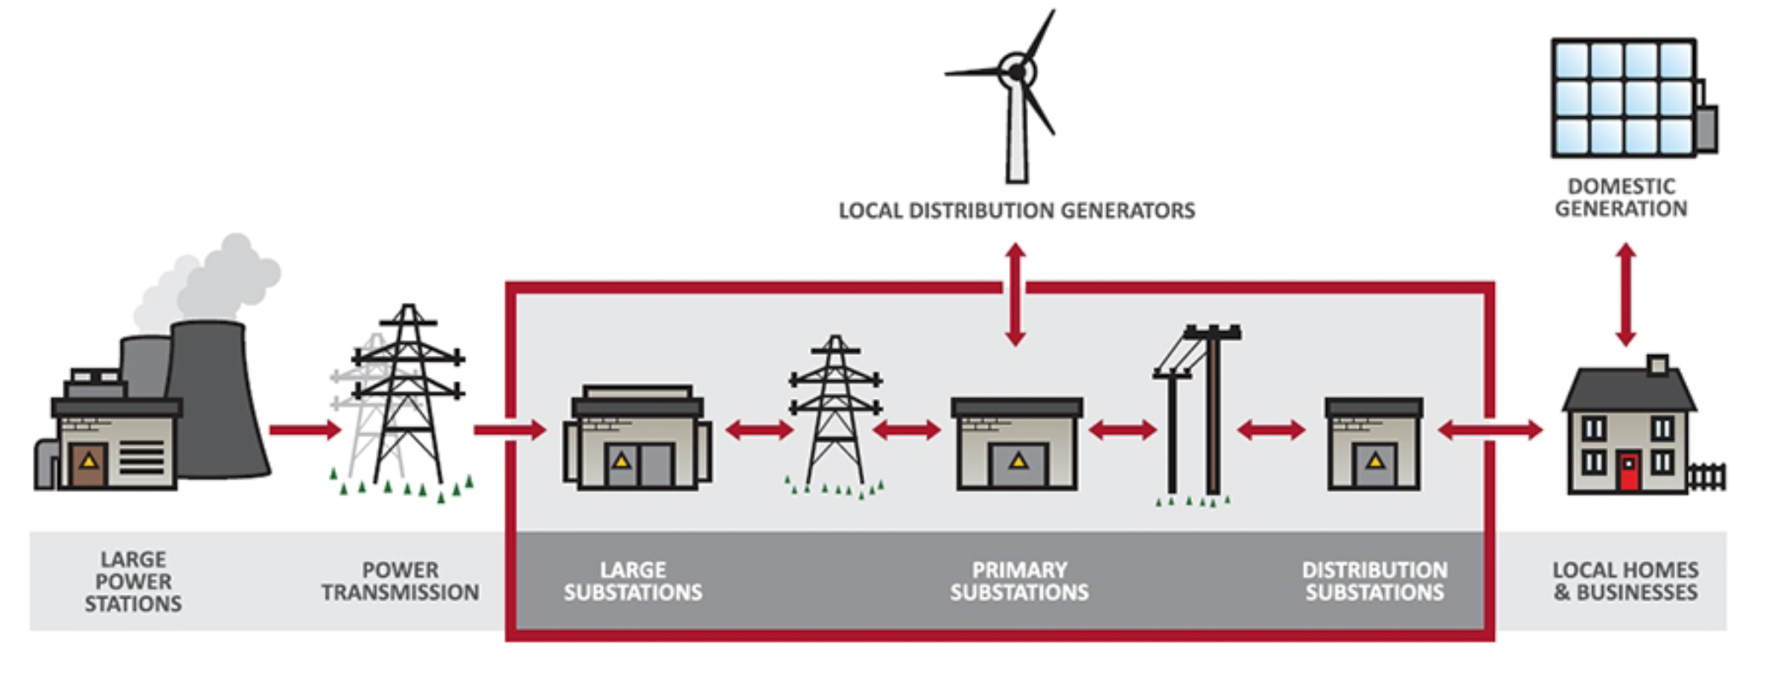
Northern Powergrid is the Distribution Network Operator (DNO) for the North East of England, Yorkshire and northern Lincolnshire.
We distribute electricity to 3.9 million homes and businesses.
As a DNO we do not own the energy we distribute – we charge electricity suppliers for the use of lines and cables to move energy they purchase from generators to the customers they supply.
This charge to suppliers represents around 10% of customer’s bills.

Slide 3
Starter:
What is renewable energy?
What sources/ types of renewable energy exist?
What are the positives and negatives of each renewable energy source?
Notes:
Show a series of pictures without giving away the topic of the lesson.
Students to discuss what they think is happening in the pictures.
What are the issues for consideration?
What lies within our areas of responsibility?
What are the immediate priorities? Consider the What, Why, When and How when exploring solutions.
Who else do we need to work with?
How do you think people feel?

Slide 4
Today’s Focus: Wind Turbines

Slide 5
Advantages: Wind is renewable and not dependant on fossil fuels. Disadvantages: Wind farms can be noisy and spoil views. If there’s no wind, they can’t generate electricity.

Slide 6
Scenario
The local council aspires to be the first ‘green’ town and has received funding to invest heavily in renewable energy. The problem is, the council have decided on wind turbines without taking into consideration any of the local residents’ feelings.

Slide 7
The community have expressed their concerns to the local council who have agreed to have a community meeting to enable local residents to present their thoughts on the proposed plans.
Notes:
In this context, “power sharing” refers to multiple households drawing their power from a limited supply of generators. Power sharing means households may only have limited access to electricity, to fulfil their basic energy needs.

Slide 9
TASK:
In groups, you are going to be given the character of a local resident. You need to come up with where, if anywhere, you think the wind turbines should be placed in the town. Alternatively, you need to come up with other renewable energy options.

Slide 10
TASK:
By the end of the lesson, you need to have come up with an argument as to where the wind turbines should be placed and why. Every other group, including the local council, will have the opportunity to question your ideas – so be ready with your answers!

Slide 11
Resident 1
A Conservationist
Notes:
Think, pair, share = take a minute to think, discuss this with a partner, then share yours ideas with the class.

Slide 12
Resident 2
A School Teacher
Notes:
Think, pair, share = take a minute to think, discuss this with a partner, then share yours ideas with the class.

Slide 13
Resident 3
A Business Owner
Notes:
Think, pair, share = take a minute to think, discuss this with a partner, then share yours ideas with the class.

Slide 14
Resident 4
A Doctor
Notes:
Think, pair, share = take a minute to think, discuss this with a partner, then share yours ideas with the class.

Slide 15
Resident 5
A Homeowner
Notes:
Think, pair, share = take a minute to think, discuss this with a partner, then share yours ideas with the class.

Slide 16
Resident 6
A Farmer
Notes:
Think, pair, share = take a minute to think, discuss this with a partner, then share yours ideas with the class.

Slide 17
At the community group...
First, the local council will present the argument for the proposed plan first.
Next, the other groups will put across their arguments. Everyone will be given an opportunity to ask questions - so listen carefully!
Notes:
In this context, “power sharing” refers to multiple households drawing their power from a limited supply of generators. Power sharing means households may only have limited access to electricity, to fulfil their basic energy needs.

Slide 18
Next Steps
For homework you are going to develop your persuasive writing skills. Your task is to write a letter to the local council expressing your views regarding the proposal. You should write is as if you were a resident. Don't forget to make use of the techniques opposite:
Alliteration
Facts
Opinion
Rhetorical question
Emotive language
Statistics
The power of three

Slide 19
Well done!

