Slide 1

Community and
Vulnerability
www.northernpowergrid.com/education

Slide 2

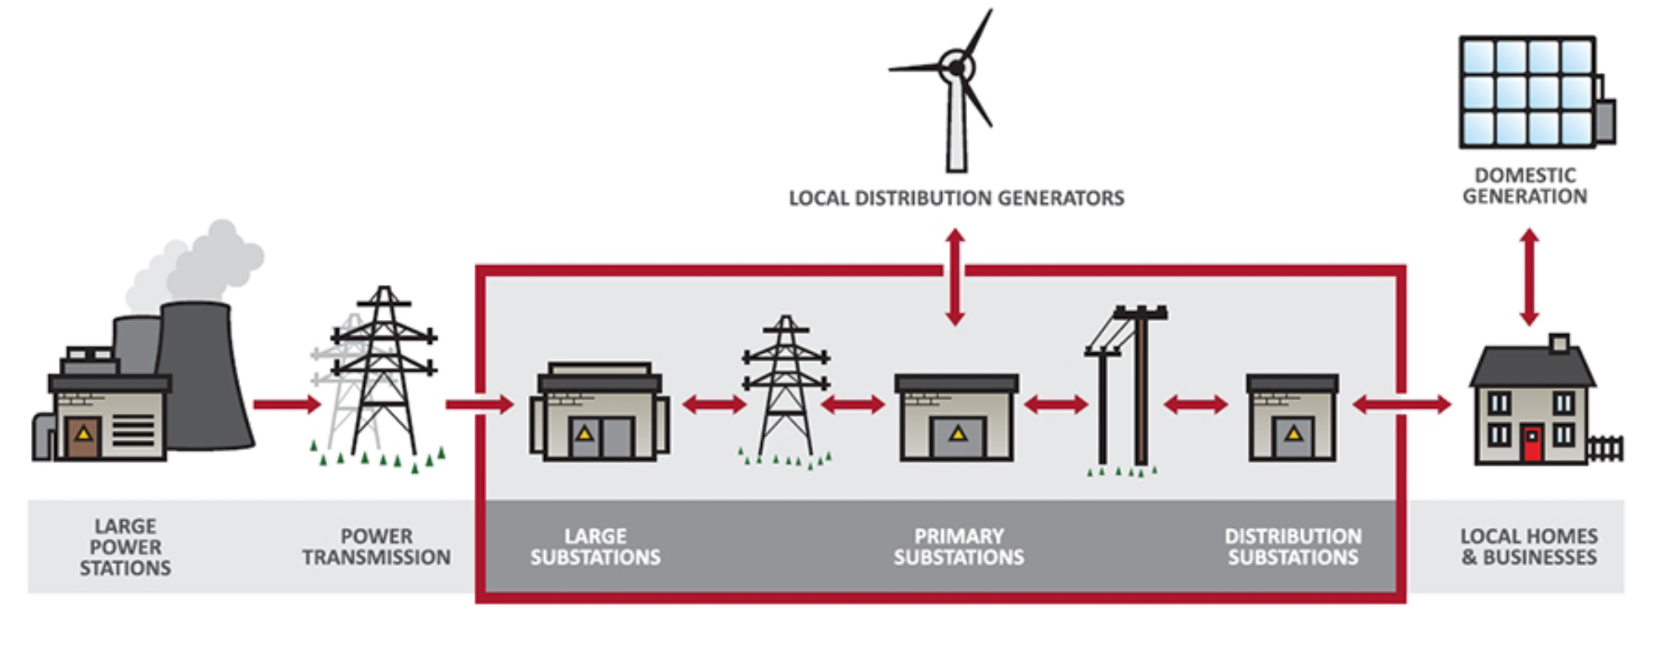
Northern Powergrid is the Distribution Network Operator (DNO) for the North East of England, Yorkshire and northern Lincolnshire.
We distribute electricity to 3.9 million homes and businesses.
As a DNO we do not own the energy
we distribute – we charge electricity suppliers for the use of lines and cables to move energy they purchase from generators to the customers
they supply.
This charge to suppliers represents around 10% of customer’s bills.

Slide 3
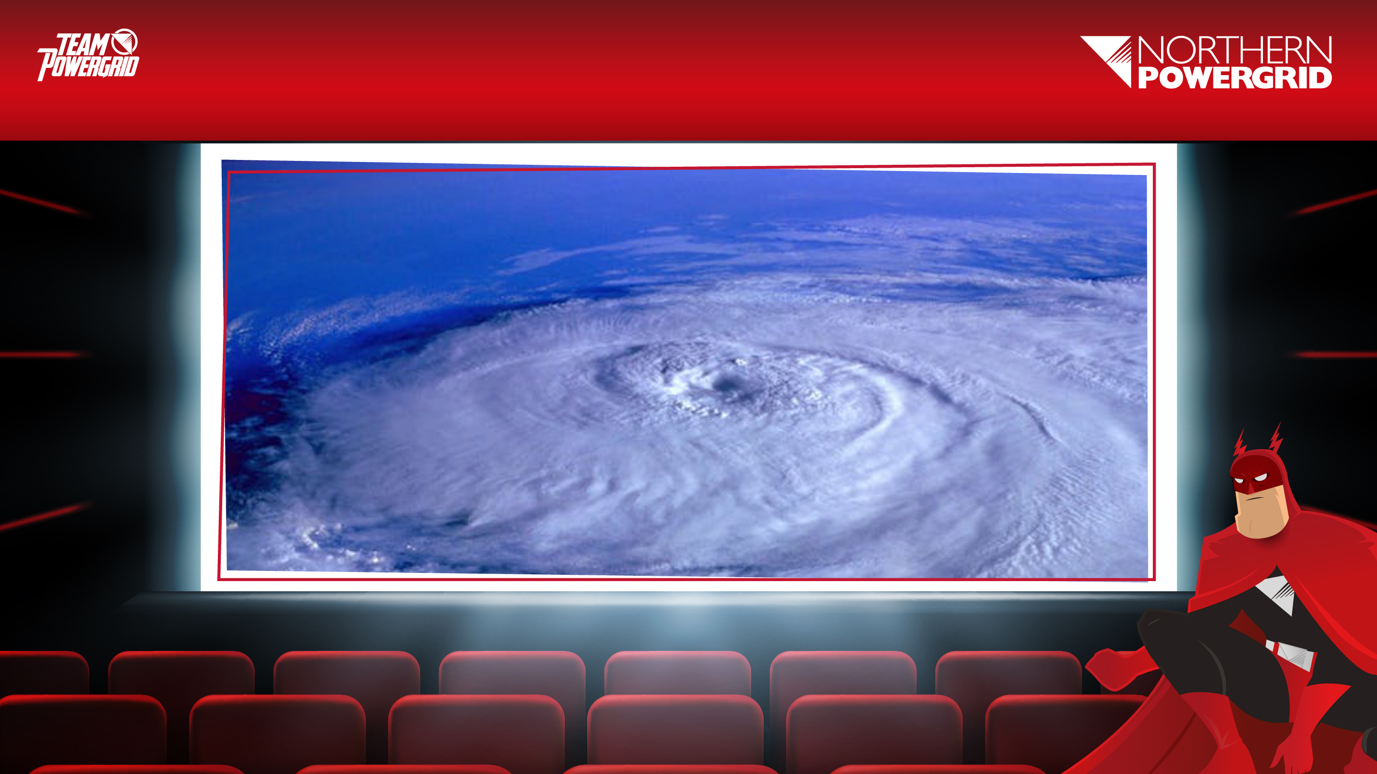
Notes:
Show a series of pictures without giving away the topic of the lesson.
Students to discuss what they think is happening in the pictures.
What are the issues for consideration?
What lies within our areas of responsibility?
What are the immediate priorities? Consider the What, Why, When and How when exploring solutions.
Who else do we need to work with?
How do you think people feel?

Slide 4
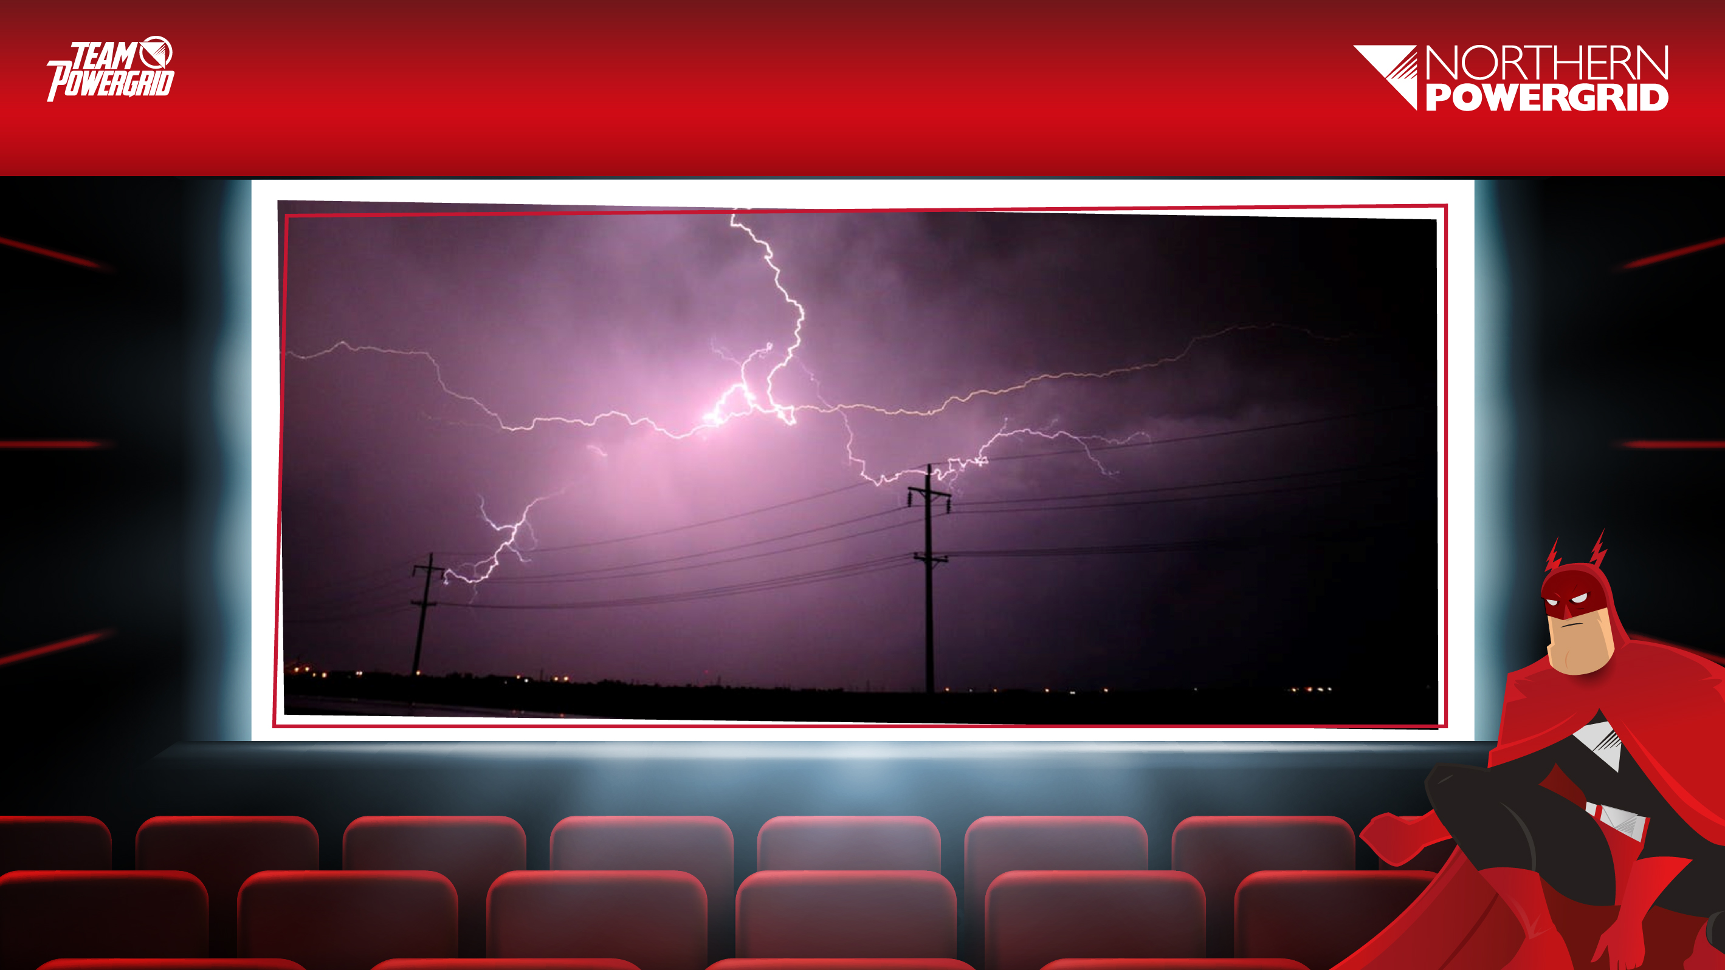

Slide 5


Slide 6
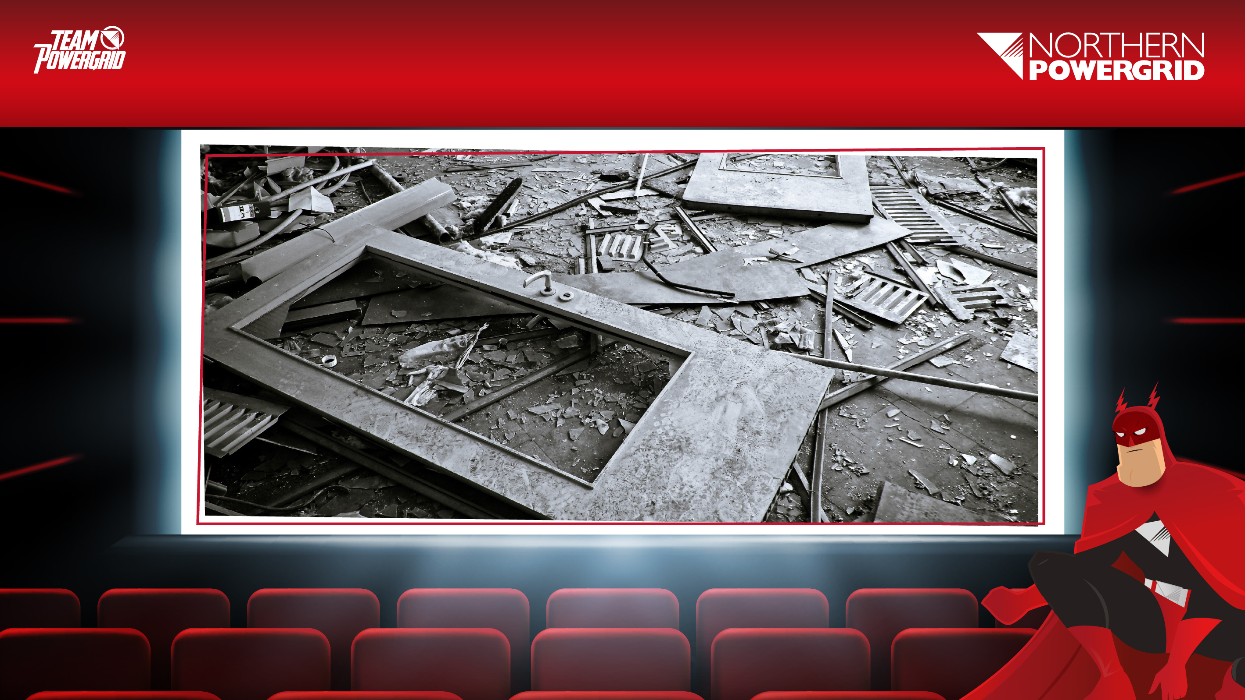

Slide 7

“To be honest, I don’t think they could have done better because they got the Red Cross out within one hour so
we could get a drink and something to eat. We were quite satisfied as during the day they kept in touch to make sure we were ok. I’m disabled and I’m on the priority list and can get in touch with them quite quickly.”
Mrs B, South Yorkshire

Slide 8
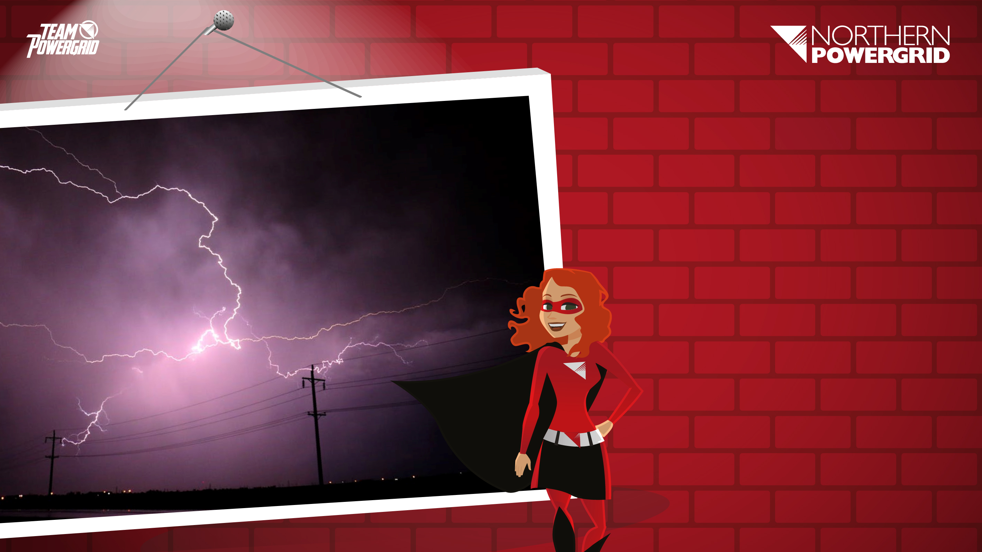
Scenario
It is mid September.
A series of freak storms have hit the UK.

Slide 9
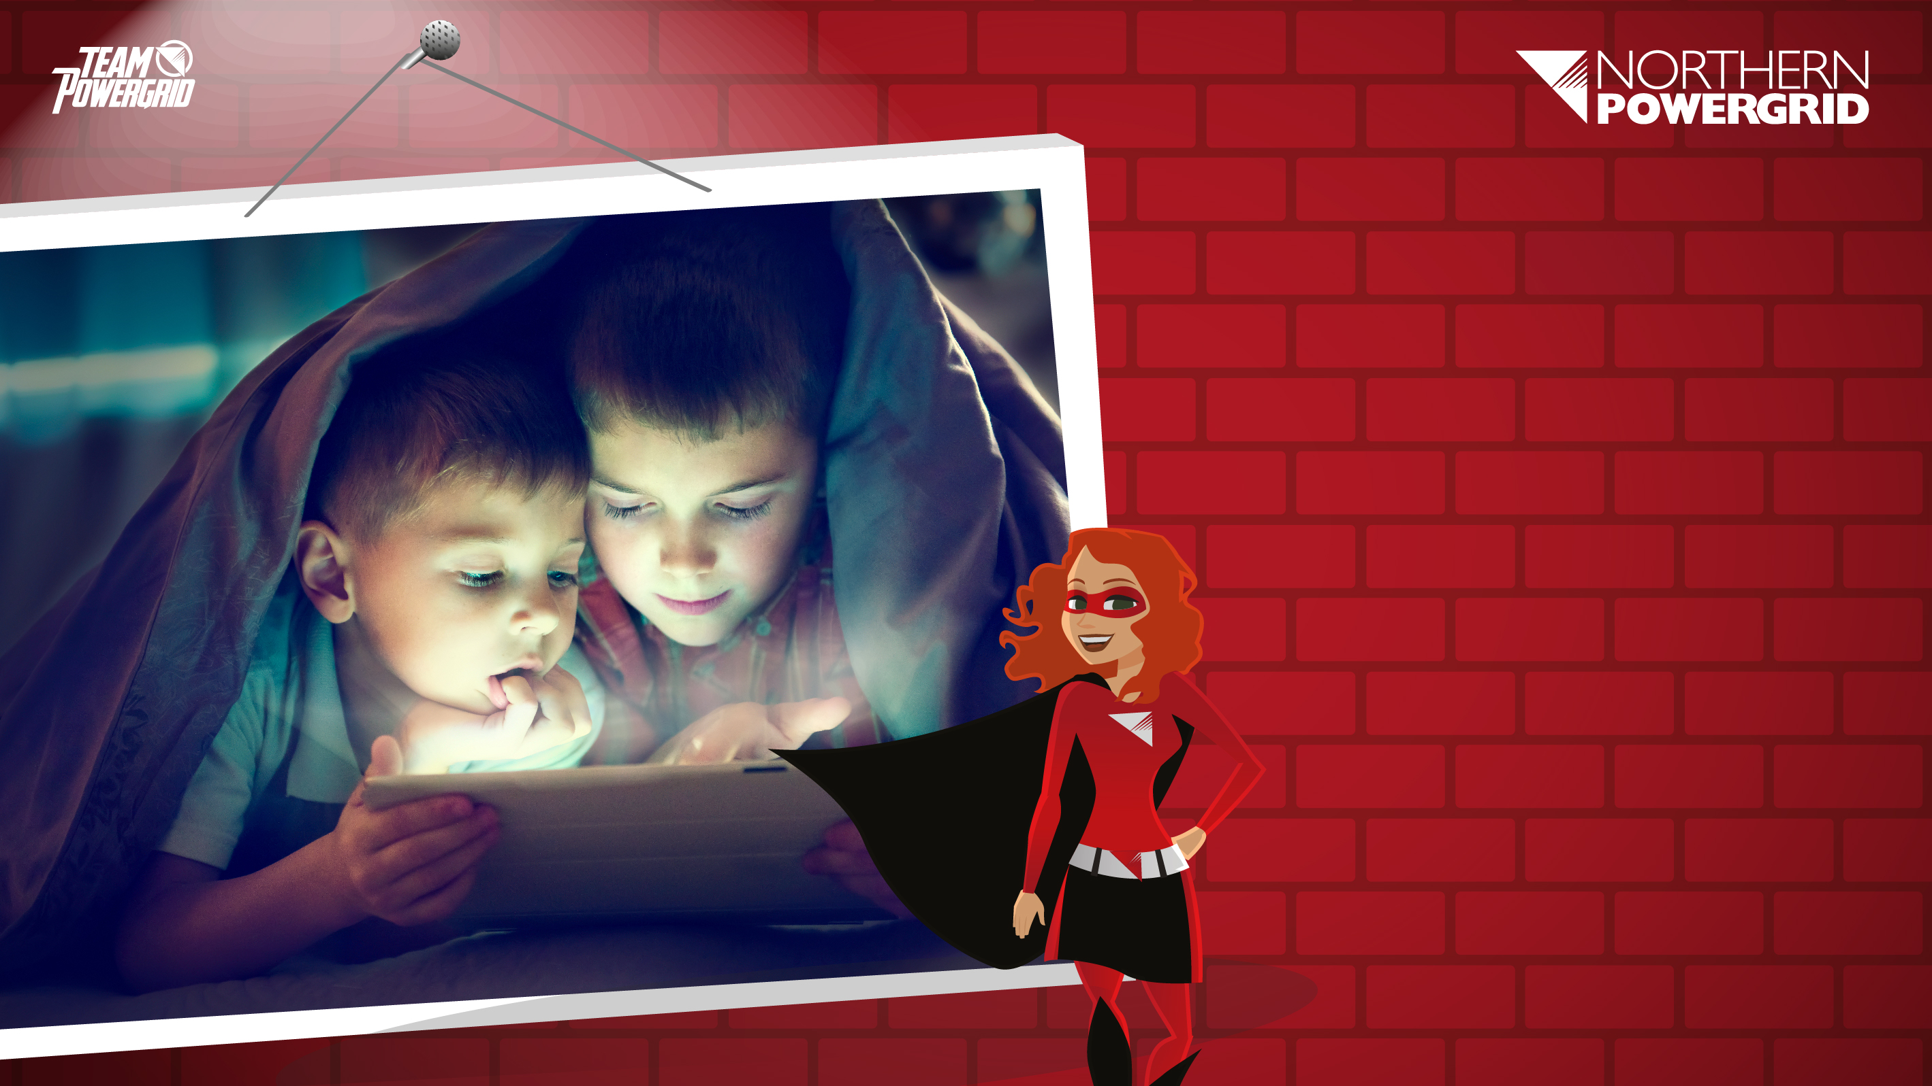
‘Power sharing’ has been put into place. The cables will take 2 weeks to repair. Emergency response protocols have been implemented and power sharing rotas will be in place over the next two weeks.
Electricity generation
and distribution has
been reduced.
Notes:
In this context, “power sharing” refers to multiple households drawing their power from a limited supply of generators. Power sharing means households may only have limited access to electricity, to fulfil their basic energy needs.

Slide 10
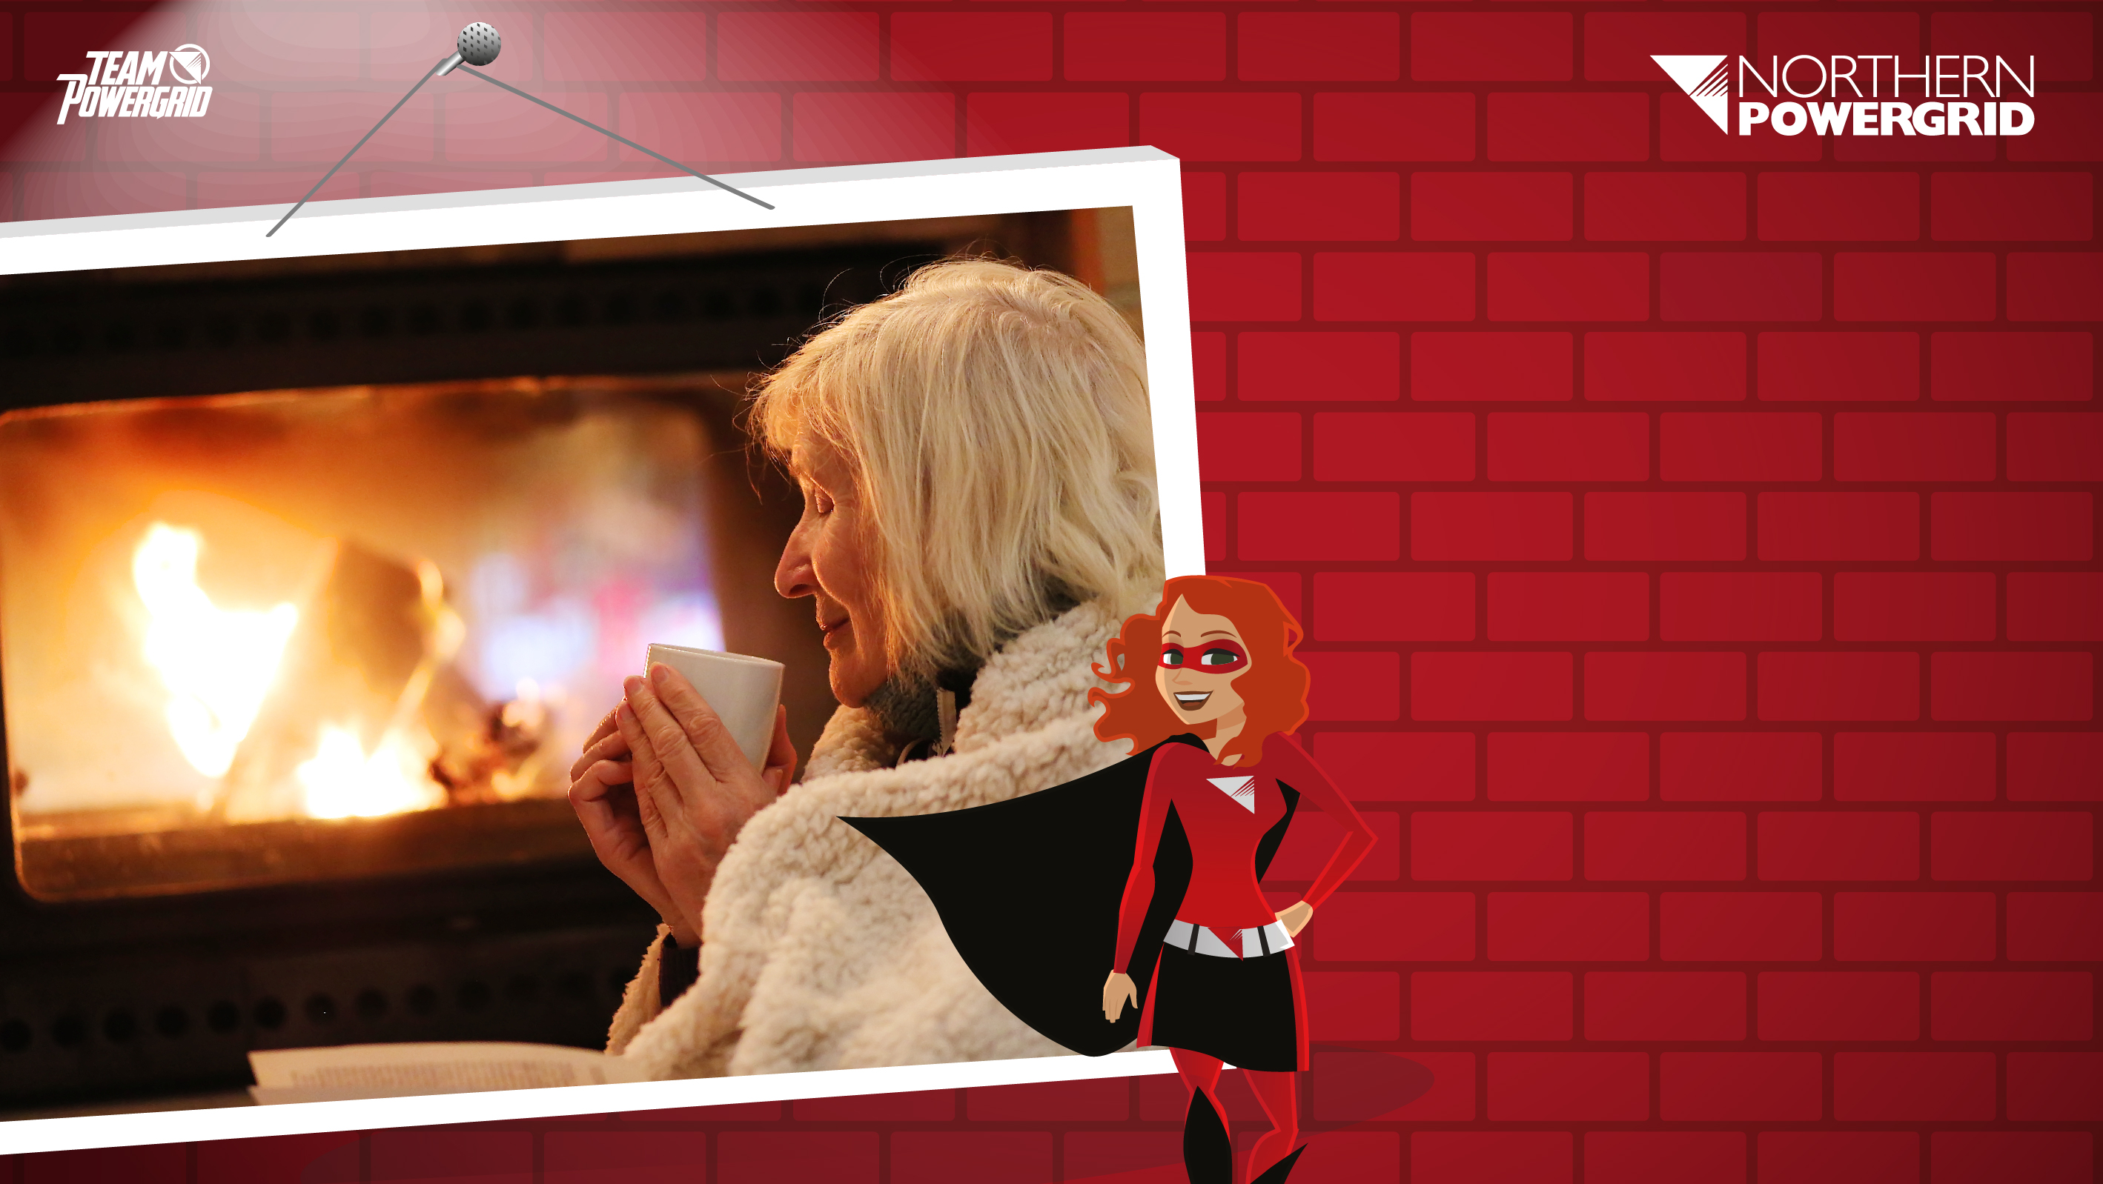
Power sharing means people will be able to receive electricity in
6 hour slots, but some people will require electricity most or all
of the time.
There are some generators which can be used for the most vulnerable in the community.

Slide 11

What and who will be affected?
Think, Pair, Share
What would you need to consider for yourself and your community in a power cut?
What actions would you
need to take?
Notes:
Think, pair, share = take a minute to think, discuss this with a partner, then share yours ideas with the class.

Slide 12

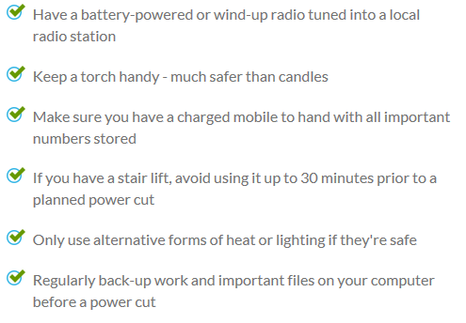
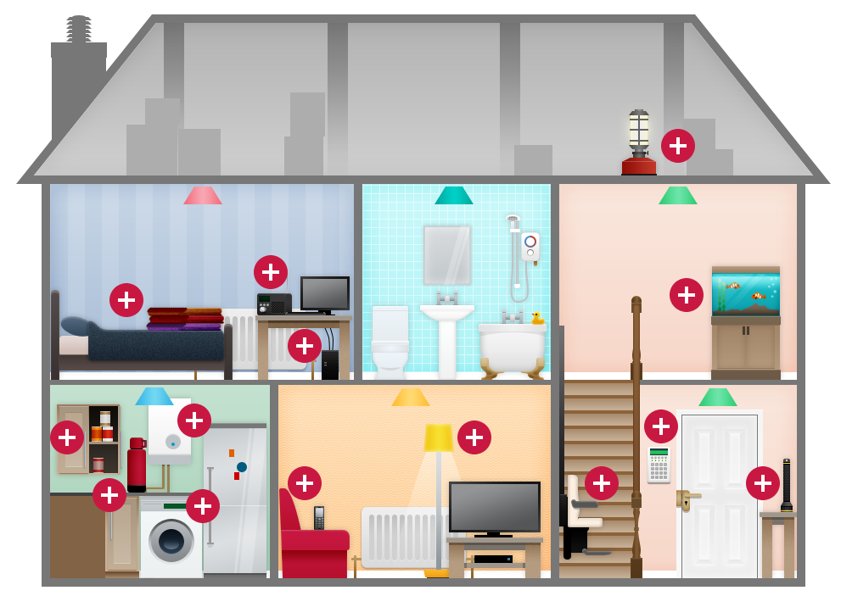
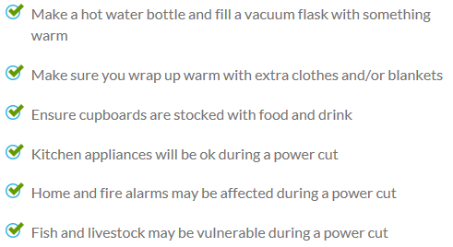
Northern Powergrid’s Advice on how to Prepare for a Power Cut
Gas appliances should still work during a power cut

Slide 13

KEEP CALM AND CARRY ON
Identify specific communities/ infrastructure that would need electricity to enable the UK to continue to function normally.
Who should receive the most power and why?

Slide 14

Vulnerable
Groups

Slide 15

What do we mean by ‘vulnerable’?
What groups of people may be vulnerable?
In groups research 'vulnerability' - what does it mean and who might it impact?
HINT: Northern Powergrid recognises that some of its customers are vulnerable. Look at the website to find out more about how it helps those customers.
www.northernpowergrid.com/care
Notes:
Link to priority service registration process is embedded in slide and included below:
https://www.northernpowergrid.com/care

Slide 16

Time to share your findings with the rest of the class.

Slide 17
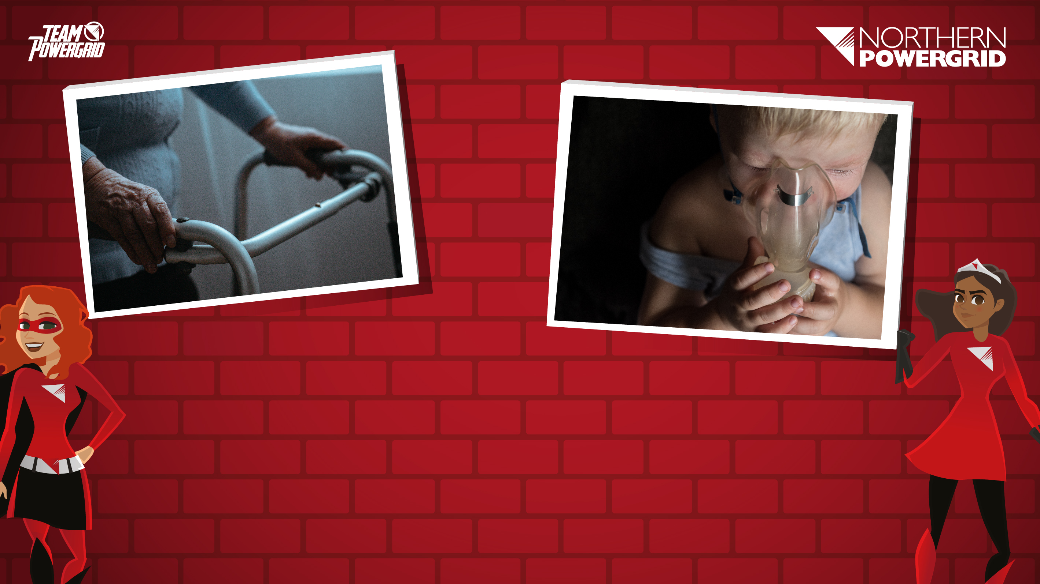
What do Northern Powergrid offer to its vulnerable customers?
Free services to customers with
additional needs, such as:
Services in different languages, additional communication, winter warmer packs (blanket, scarf, gloves etc), generators, help to find alternative accommodation, provide support through the British Red Cross.
Across the country
The protections put in place by DNOs across the UK meant that more than 85,000 customers were provided with extra help when their supply was interrupted during the 2013-2014 storms.
Note: DNO = Distribution Network Operator; Northern Powergrid is a DNO
Notes:
Although Ofgem have a full strategy that outlines how energy companies should define, identify and support/ respond to vulnerable customers, they also have a much shorter summary of the “Top 10” tips for supporting vulnerable customers. This slide gives a few relevant excerpts.
https://www.ofgem.gov.uk/sites/default/files/docs/2015/10/er_top_ten_tips_v4_2_0.pdf

Slide 18

Task
Power sharing is in place in your community for 2 weeks.
Who do you think are the most vulnerable?
Who do you think should receive the generators, what issues should be considered?
How else could vulnerable people in your community be supported?

Slide 19

Task
Aim: For the local area to continue as normal where possible, but ultimately the focus must be on the safety and wellbeing of those who need it most.
Be ready to present your ideas to the rest of the class at the end of the lesson.

Slide 20
Class Discussion – Next Steps
Prepare a menu showing what you could eat for breakfast, lunch and dinner if power were switched off at this time.
What sort of food could you eat and why?
Think about your choice of food and ingredients in terms of: lack of electrical cooking appliances, freezing and refrigeration.
Are there any other factors you would need to consider? Make a note of them and indicate how your menu takes these into consideration.

Slide 21

Well done!

